Slide 1


Enabling Open Science across the CIVICA Alliance
Speakers: Rosie Higman, Open Research Services Manager, Library, LSE
LSE Library

Slide 2











OS across CIVICA
lse.ac.uk/library
LSE Library

Slide 3
CIVICA Open Science – Initial Phase
OS across CIVICA
January 2021 to December 2023
Aiming to develop an Open Science plan and principles across the CIVICA institutions
Key actions and achievements:
  Collaborative working group launched for Open Science strategies.
  Open Science Barometer: Evaluated institutional Open Science policies, infrastructure, and training.
  Open Science Action Plan: Framework built around Open Access, FAIR Data, & Citizen Science.
  Training & Engagement Initiatives: Open Science webinars featuring young researchers' experiences.
lse.ac.uk/library
LSE Library

Slide 4
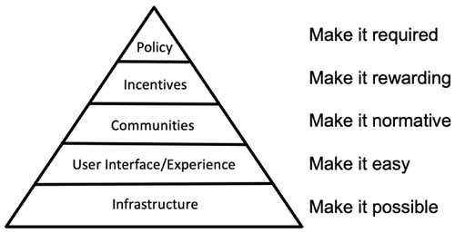
Open Science Communities in CIVICA
OS across CIVICA
https://www.cos.io/blog/strategy-for-culture-change
lse.ac.uk/library
LSE Library
Notes:
Integrate open science awareness, promotion, support and implementation activities into the CIVICA 2 project through the establishment of a researcher-centred CIVICA Open Research Community.
Enable the CIVICA alliance to focus on the specific needs of human and social sciences, which are different from other disciplines, and advocate for them.

Slide 5
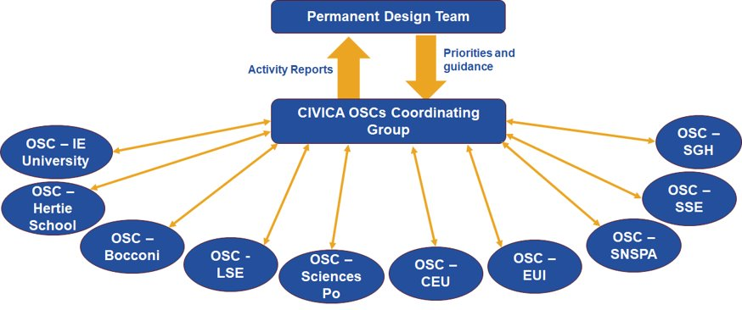
Open Science Communities in CIVICA
OS across CIVICA
lse.ac.uk/library
LSE Library

Slide 6
Growing communities
OS across CIVICA
Nov. 2024
First meeting of the Open Science Coordinating Committee.
Jan.–Mar. 2025
First cohort completes the INOSC toolkit (1 hour/week).
Apr. 2025
Second meeting of the Open Science Steering Committee to share lessons learned.
June 2025
Launch of the first CIVICA Open Science Communities.
6 week incubator programme based on INOSC toolkit, focused on community building
Enthusiastically received
Key challenges:
Differences in capacity and knowledge
Lack of incentives in some contexts
lse.ac.uk/library
LSE Library

Slide 7


Open Science Community at LSE
OS across CIVICA
LSE Library

Slide 8

An informal group of researchers, academics and professional services staff from across LSE…[aiming] to provide strategic direction for open research support at LSE, and to foster a culture of open, transparent, inclusive, and collaborative research across the School.
OS across CIVICA
LSE Open Research Working Group
lse.ac.uk/library
LSE Library

Slide 9
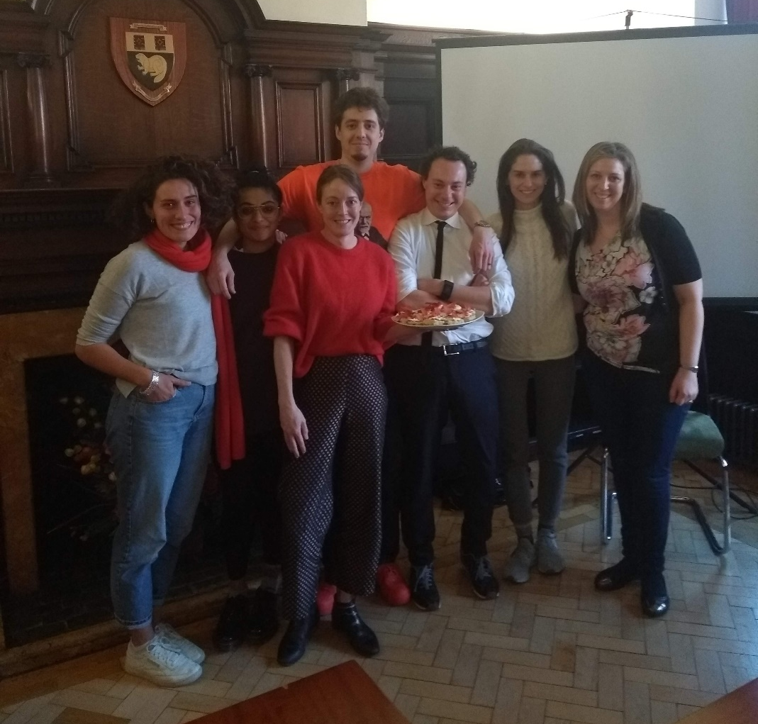

Open Research Working Group
OS across CIVICA
Began with local Reproducibility Network in 2018
Member of UK Reproducibility Network (2019/2025)
Hosted the 2025 annual retreat for 35+ UKRN Local Network Leads
Chaired by Dr Matteo M Galizzi, Associate Professor of Behavioural Science, Department of Psychological and Behavioural Science and LSE Behavioural Lab
lse.ac.uk/library
LSE Library

Slide 10
Events programme
OS across CIVICA
Oct 2024: The power of editors in changing scholarly communications
Nov 2024: Reproducibility in the Age of AI
Feb 2025: Publishing Beyond Academia
March 2025: Making research on vulnerable or marginalized communities open
June 2025: Should reproducibility be the aim for open qualitative research - joint event with UCL
June 2025: How open is possible, how closed is necessary? - joint event with UCL
June 2025: Open research in the age of populism
Oct 2025: Lies and statistics? Making Quantitative Research Accessible to the Public
Nov 2025: Are we measuring the right things in the social sciences?
Jan 2026: Open Access and the Commons: The many faces of scholar-led publishing
lse.ac.uk/library
LSE Library

Slide 11
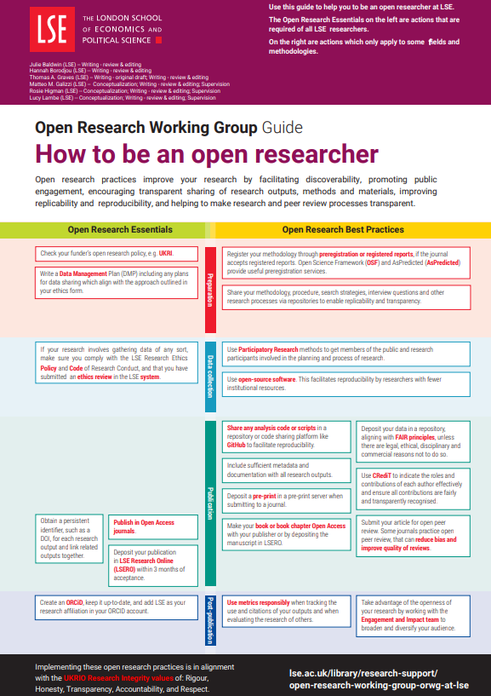
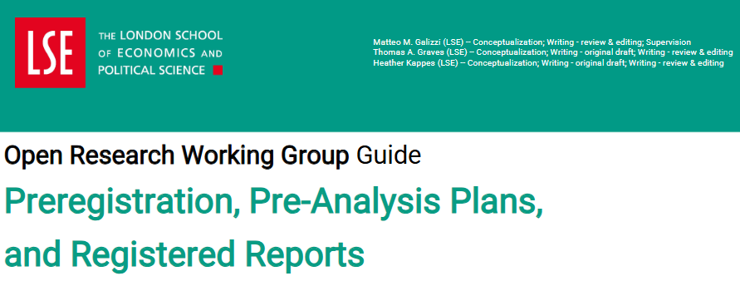

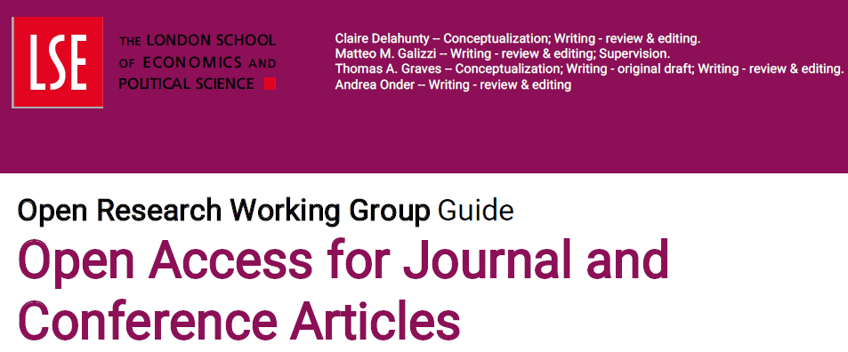
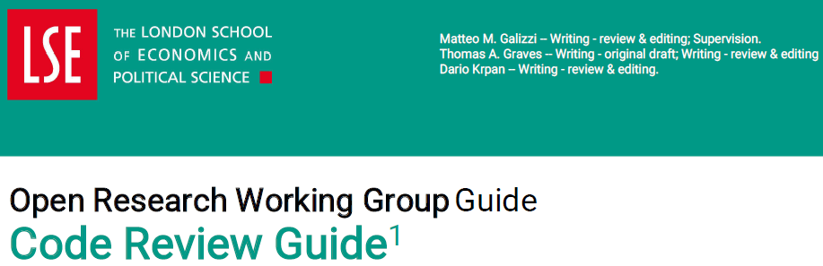
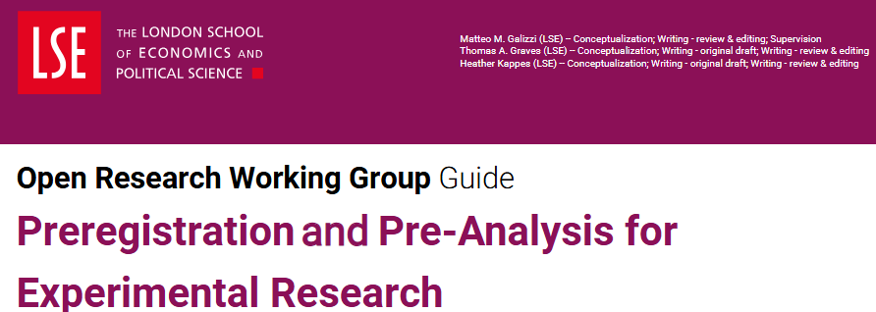
Supporting guides
OS across CIVICA
lse.ac.uk/library
LSE Library

Slide 12
Open Research Community
OS across CIVICA
Launched in September 2025, aiming to build wider engagement with Open Research
Variety of ways to engage including:
LinkedIn
Newsletter
Teams
Attendance at ORWG events
lse.ac.uk/library
LSE Library

Slide 13
Next steps for Open
Science in CIVICA
OS across CIVICA
LSE Library

Slide 14
Building our communities
OS across CIVICA
Collaborative events
Knowledge sharing across the alliance
Expert training
Developing interest and expertise in Open Educational Resources
Develop CIVICA OpenAIRE gateway
lse.ac.uk/library
LSE Library

Slide 15
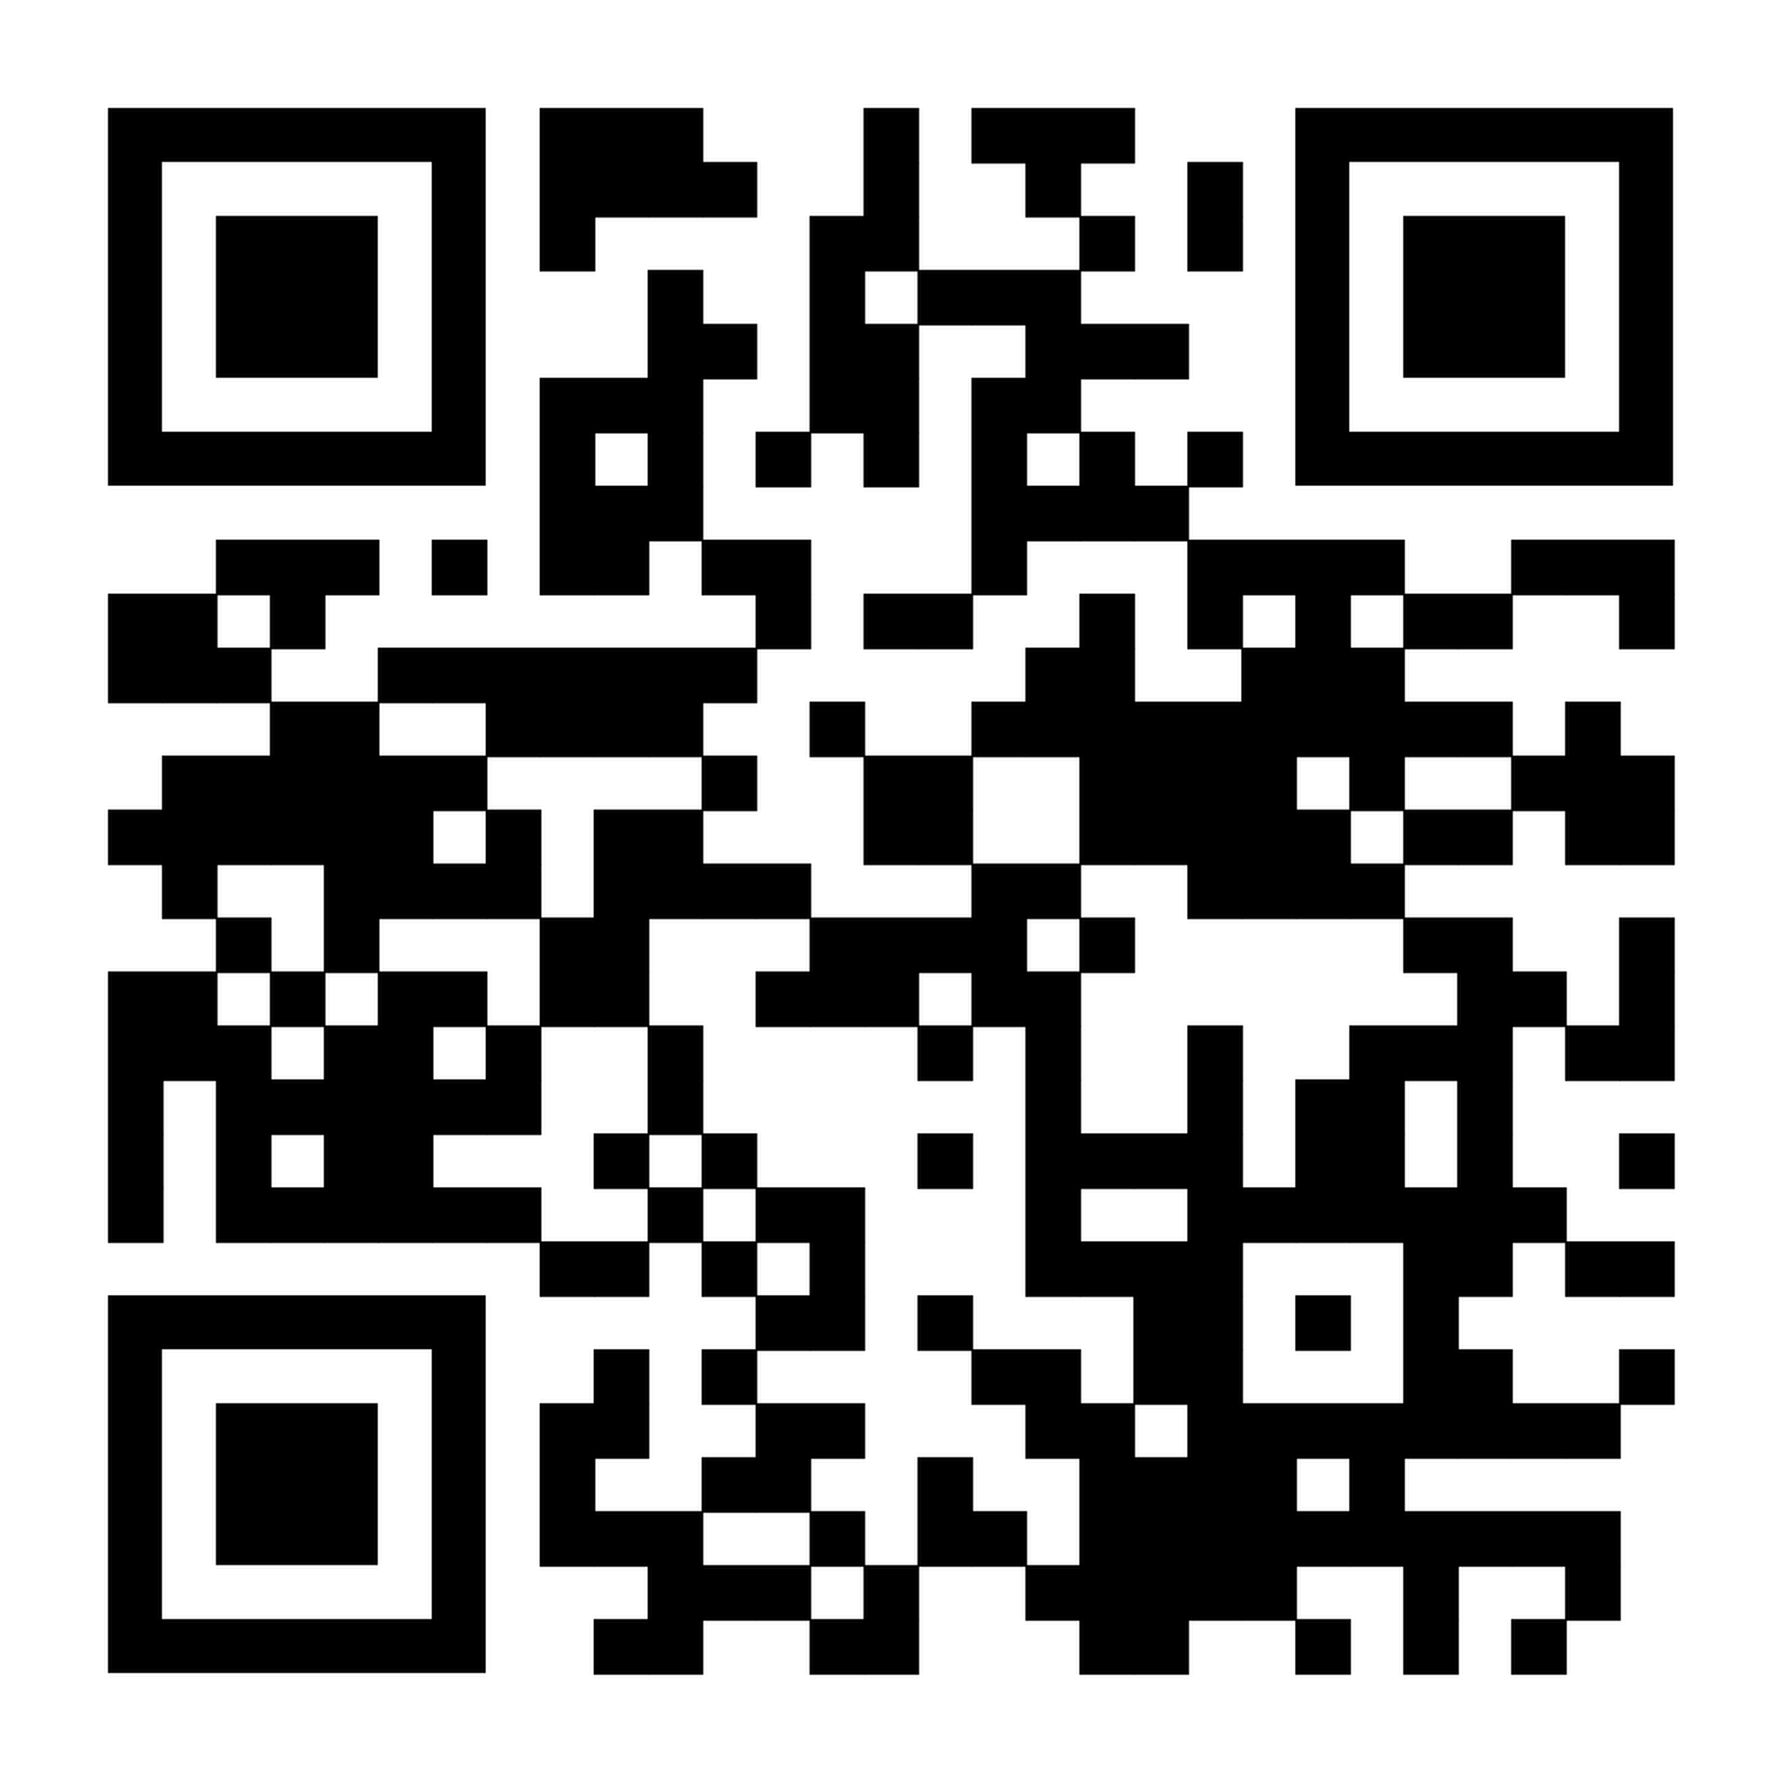
CIVICA Open Science Conference
OS across CIVICA
Wednesday 20th May
London School of Economics and Political Science
Hybrid option for some presentations
lse.ac.uk/library
LSE Library

