Slide 1


Renewing LSE Research Online
Enhancing Visibility and Impact
Speakers: Rosie Higman, Open Research Services Manager, LSE Library, LSE
LSE Library

Slide 2


LSE is a world leading university, specialising in social sciences, with a global community of people and ideas that transform the world.
Renewing LSERO
lse.ac.uk/library
LSE Library

Slide 3

Over 4.9 million downloads from LSE Research Online in 2023-24
Renewing LSERO
LSE Library Annual Report 2023-24
lse.ac.uk/library
LSE Library

Slide 4
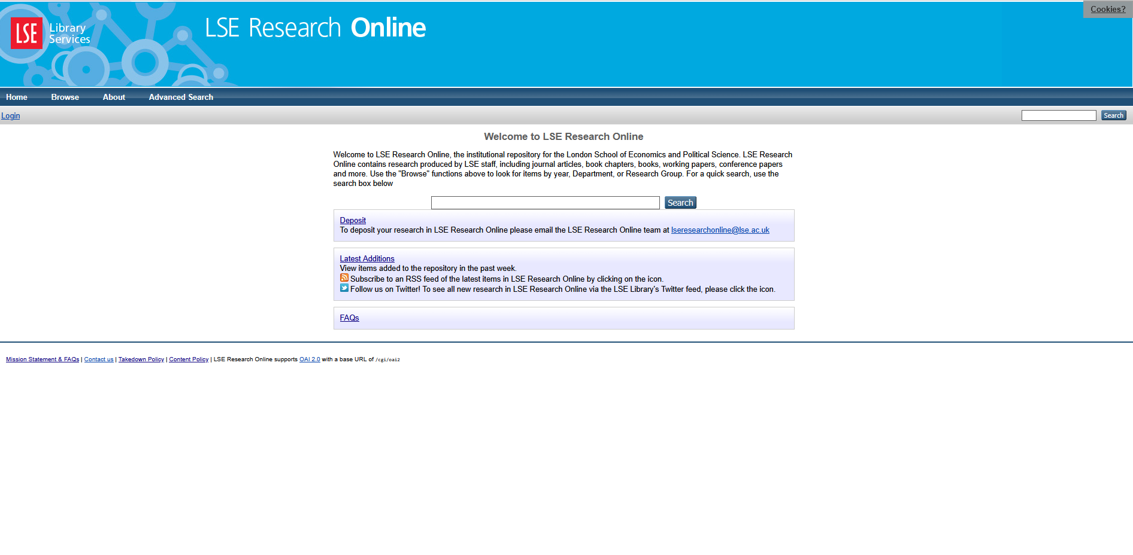
Renewing LSERO
lse.ac.uk/library
LSE Library

Slide 5
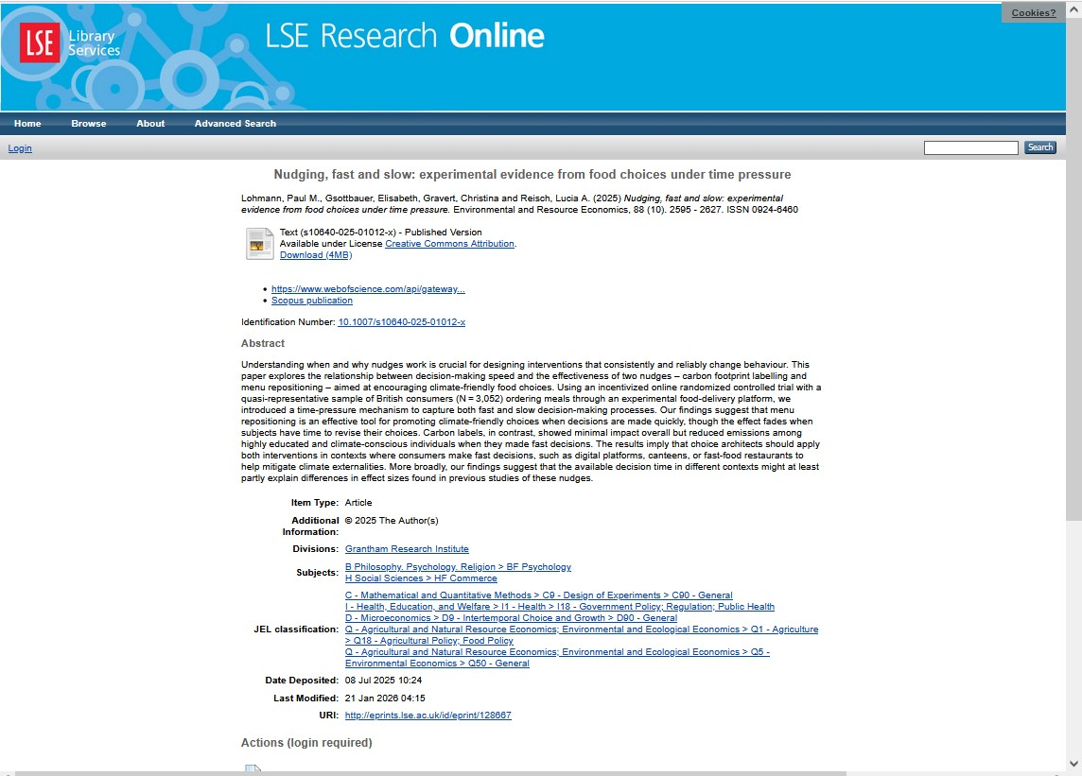
Renewing LSERO
lse.ac.uk/library
LSE Library

Slide 6
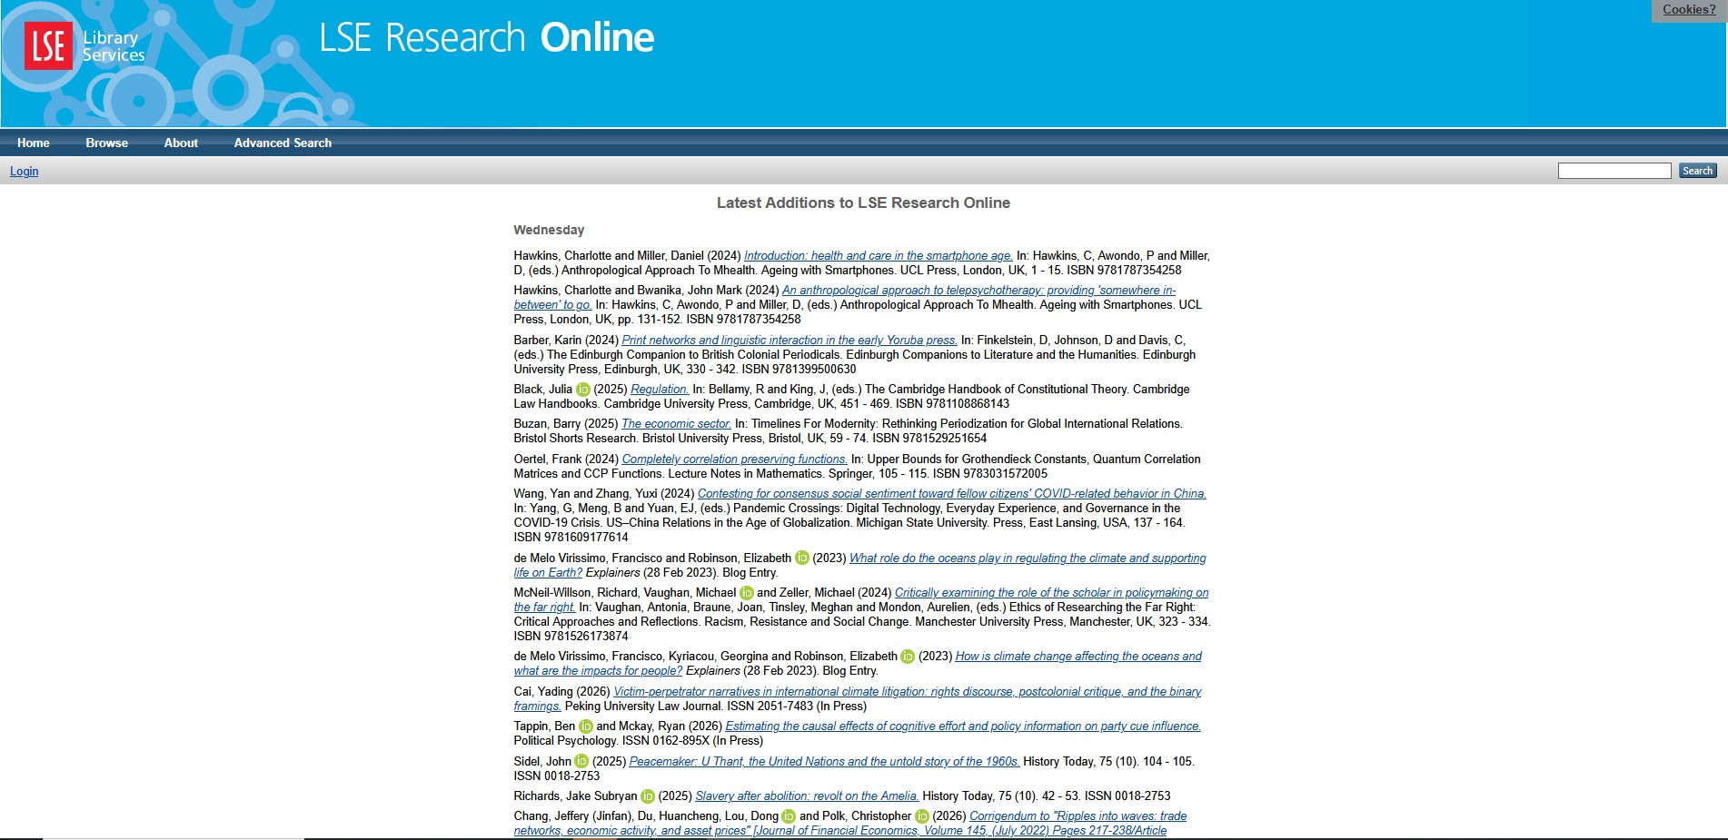
Renewing LSERO
lse.ac.uk/library
LSE Library

Slide 7
LSE Research Online renewed
All LSE research together in one place – improved searching and linking
Introducing support for research data and reproducibility packages
Enhancing the visibility of LSE research globally
Making depositing publications easier and faster
Improving stability, performance, and long‑term reliability

Slide 8
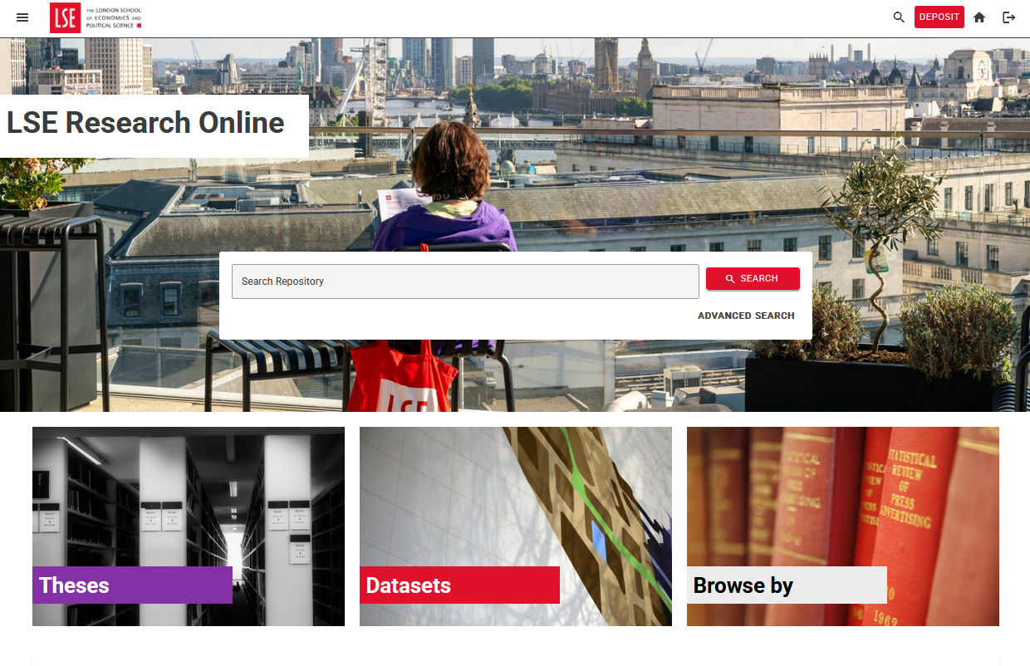
Renewing LSERO
lse.ac.uk/library
LSE Library

Slide 9
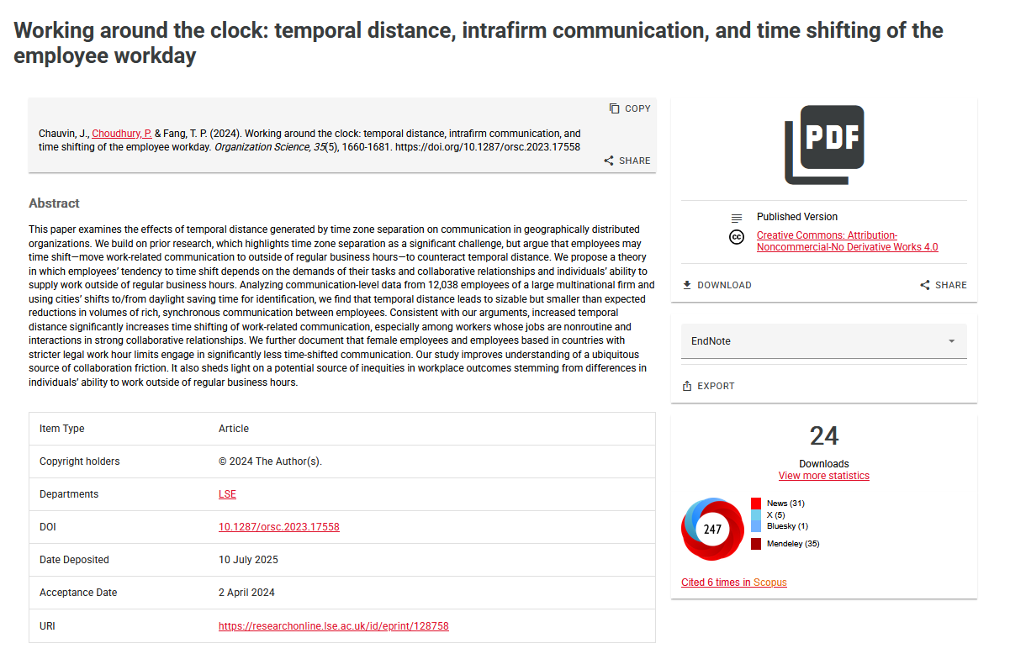
Renewing LSERO
lse.ac.uk/library
LSE Library

Slide 10
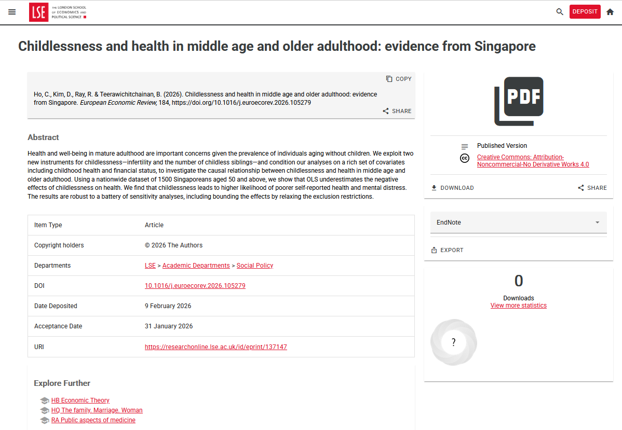
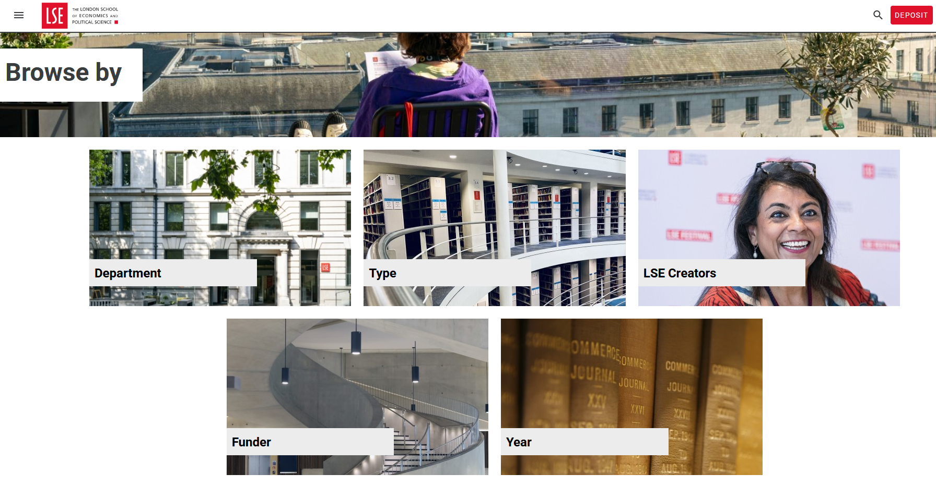
Renewing LSERO
lse.ac.uk/library
LSE Library

Slide 11
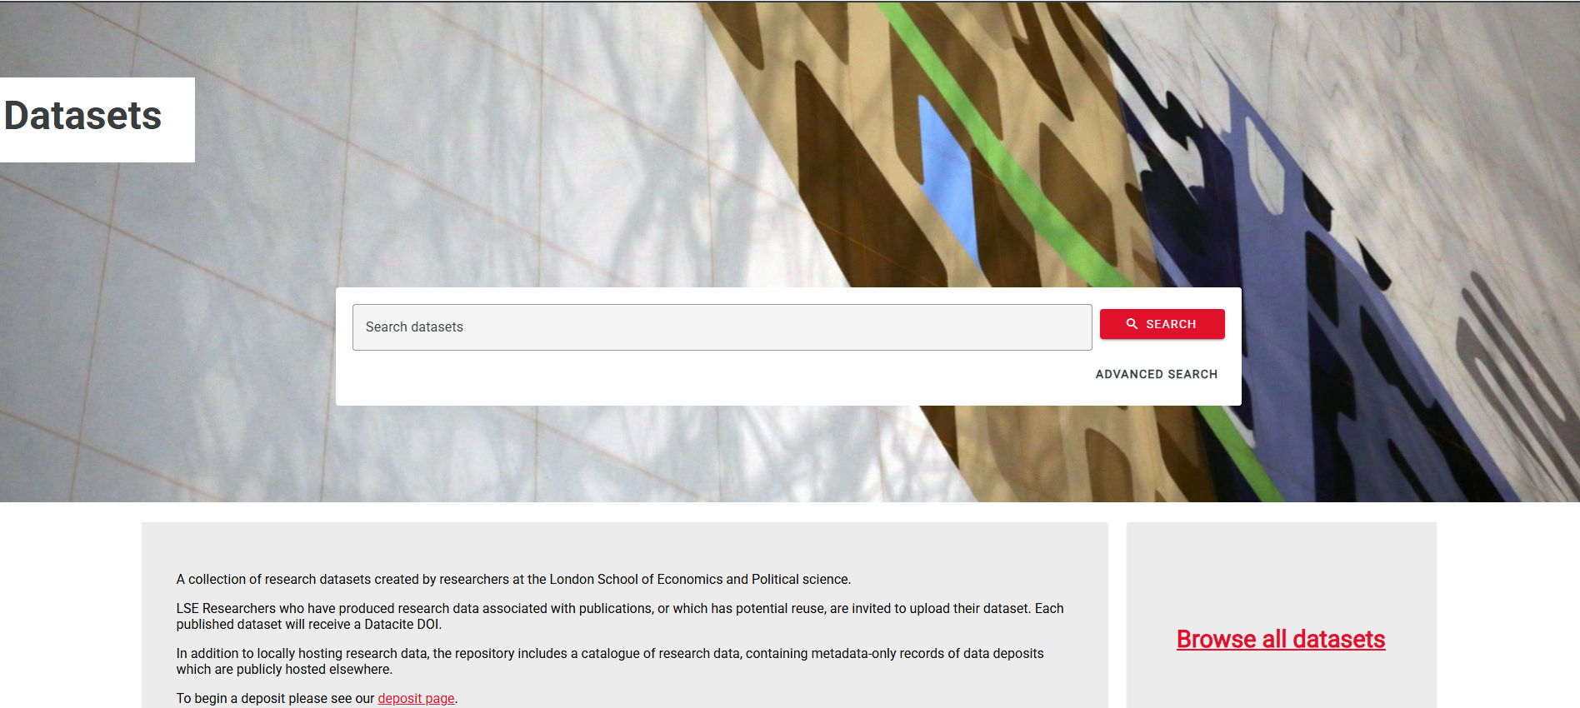
Data catalogue in LSE Research Online
1,000+ existing datasets now discoverable
Add links to external datasets to increase visibility
Can be linked to publications and theses

Slide 12
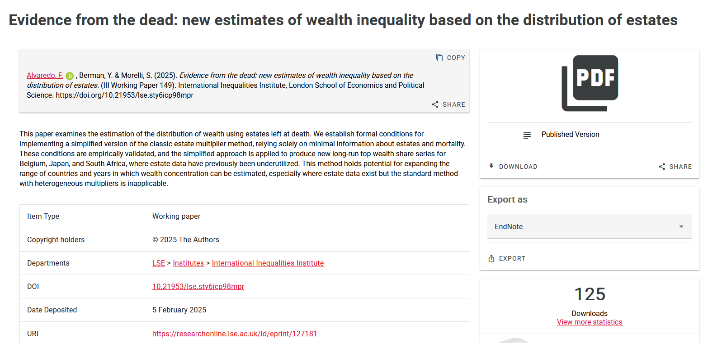
Enhanced visibility
Renewing LSERO
lse.ac.uk/library
LSE Library
Notes:
Working paper series hosted on the repository -> better indexing in G Scholar etc, get a DOI so can track citations and impact

Slide 13
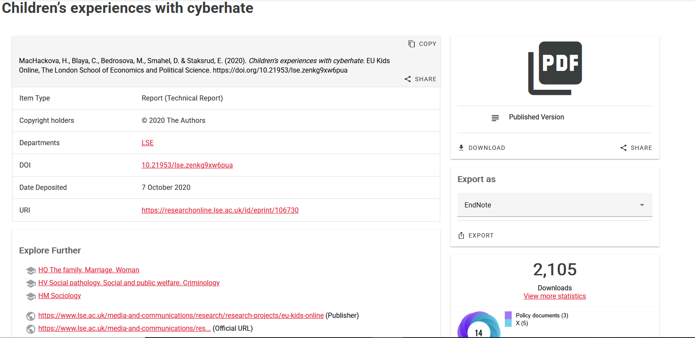
Increased Impact
Renewing LSERO
lse.ac.uk/library
LSE Library

Slide 14
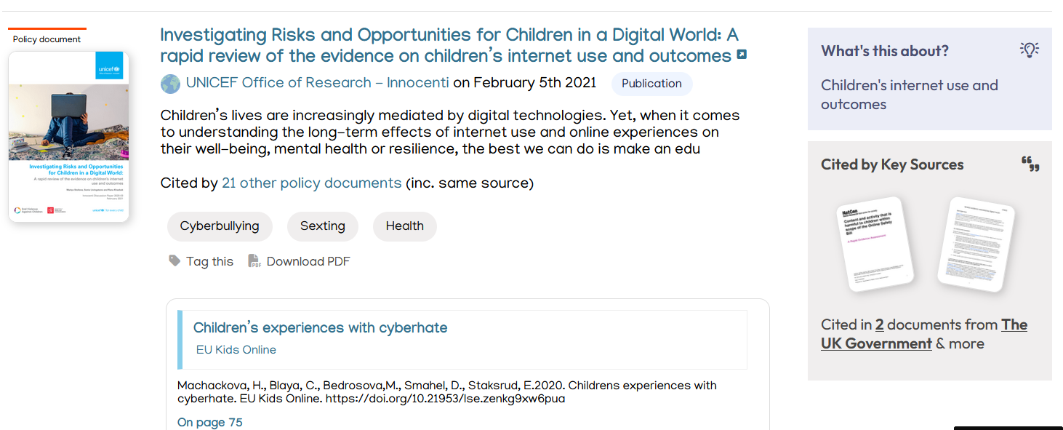
Increased Impact
Renewing LSERO
lse.ac.uk/library
LSE Library
Notes:
Cited in 8 policy sources including EU policy, OECD and UNICEF

Slide 15
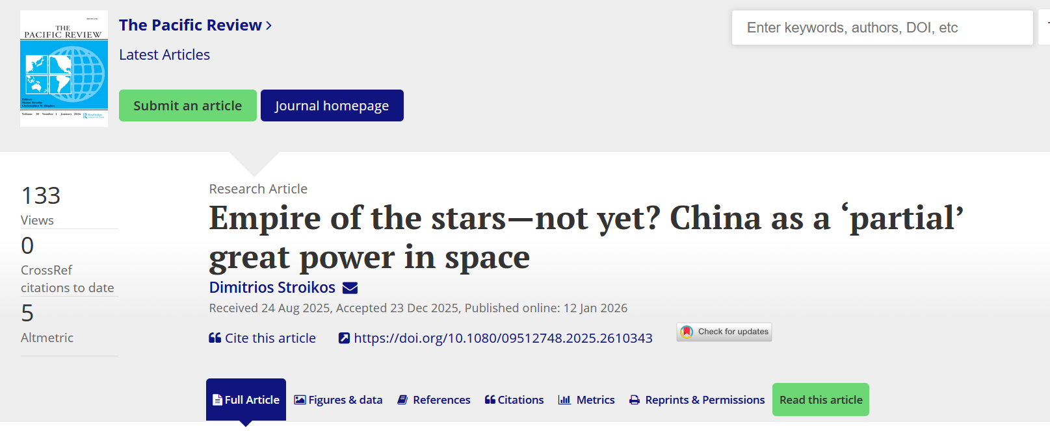
Giving researchers control
Renewing LSERO
lse.ac.uk/library
LSE Library

Slide 16
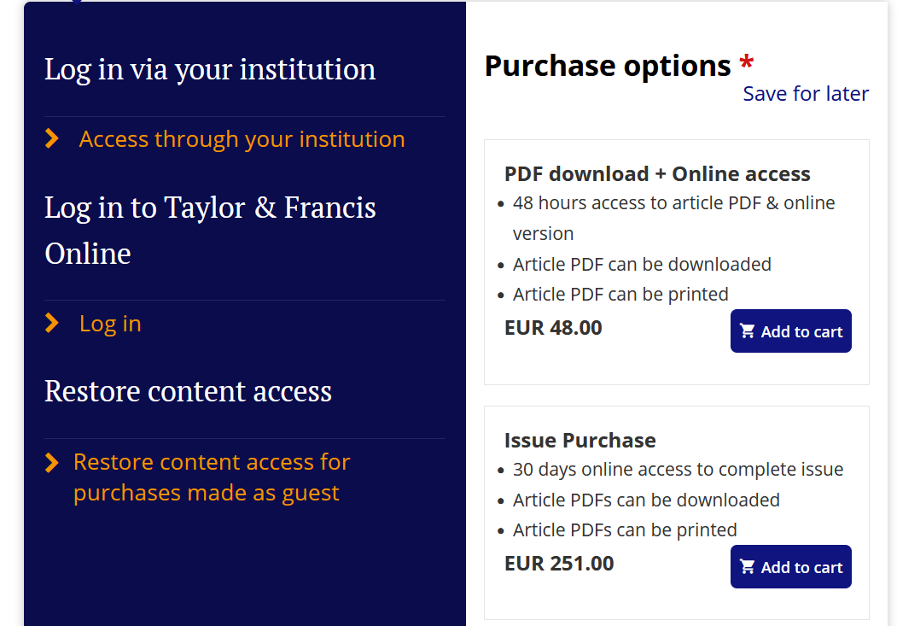
Giving researchers control
Renewing LSERO
lse.ac.uk/library
LSE Library

Slide 17
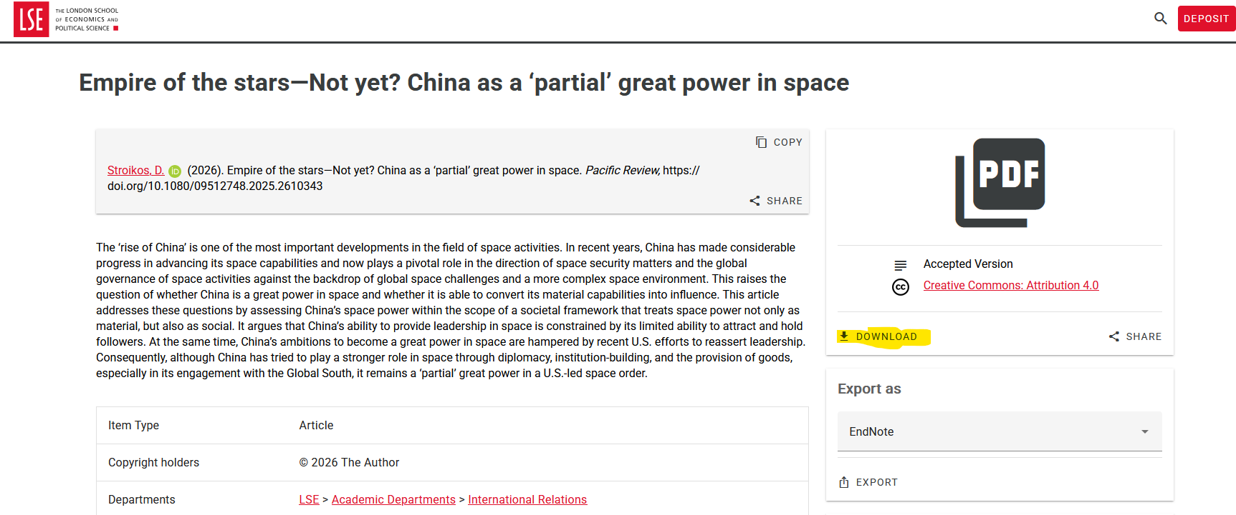
Giving researchers control
Renewing LSERO
lse.ac.uk/library
LSE Library
Notes:
18 month embargo

Slide 18
With Thanks To…
Renewing LSERO
Beth Clark, Kerrie O’Flynn, Claire Delahunty, Fran Frenzel, Helen Williams, Julie Baldwin, Clare Hudson, Crispin Williams at LSE, and Rory, Will and Eleanor at Co Sector
https://researchonline.lse.ac.uk/
lse.ac.uk/library
LSE Library

