Slide 1
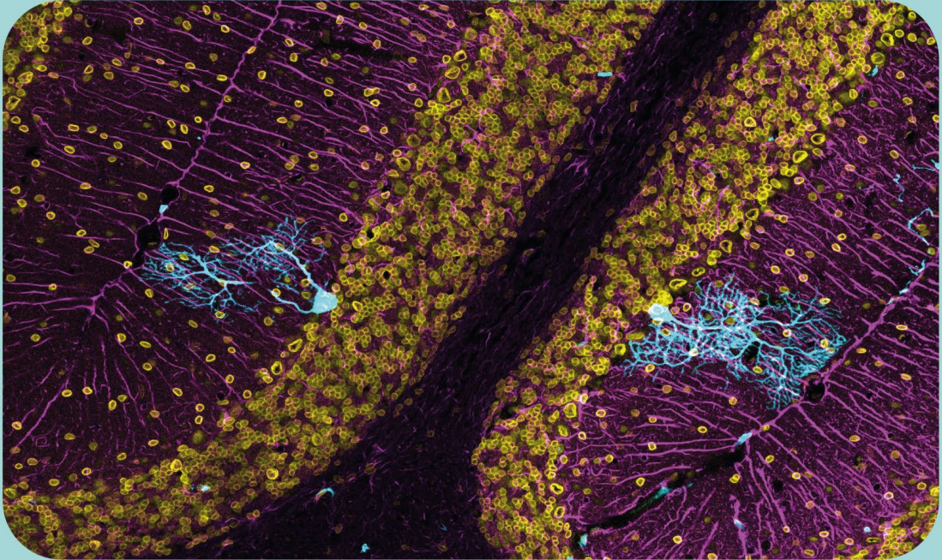
From Institutional Repositories to Global Access: RECOLECTA’s Strategic Role in Open Science
Spanish Foundation for Science and Technology, FECYT
Laura Bonora

Slide 2

FECYT Action Plan
OE1
OE2
OE3
OE4
OE5
SCIENTIFIC AND INNOVATION CULTURE
OPEN SCIENCE
INTERNATIONAL
SCIENCE FOR PUBLIC POLICY
CORPORATE CULTURE: PEOPLE AT THE CENTER
Strategic Objectives
Dissemination and public participation in Science
Scientific communication
Scientific journalism
Cultural change
Open technological infrastructures
Open science policies
Development of the European Research Area
Research career development
European Mobility Program
Scientific advice
Public experimentation and innovation
Diversification of research careers
Cultural change
Gender perspective Internationalization
Scientific careers
Promoting the value of science
Beneficiaries & Partners
RESEARCHERSAND INSTITUTIONS
Institutional strengthening
Researchers' skills and abilities
Diversification of scientific careers
EU openness: support for European participation
PUBLIC ADMINISTRATIONS
Information and tools
Science awareness for public policy
Advisory services
Establishment of channels for dialogue between science and public policy
SOCIETY
Inclusion and empowerment through science
Resilience to misinformation
Dialogue between stakeholders

Slide 3
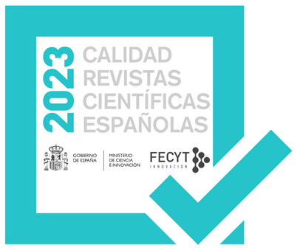
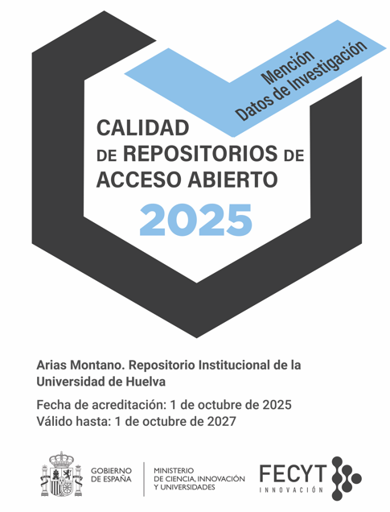


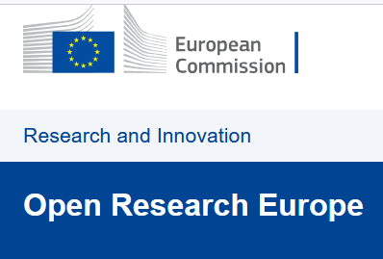

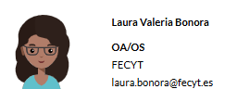

Certification
FECYT Programs
NCP
Infrastructure / Support services
Funding

Slide 4
FECYT SERVICES TO REPOSITORIES

Slide 5
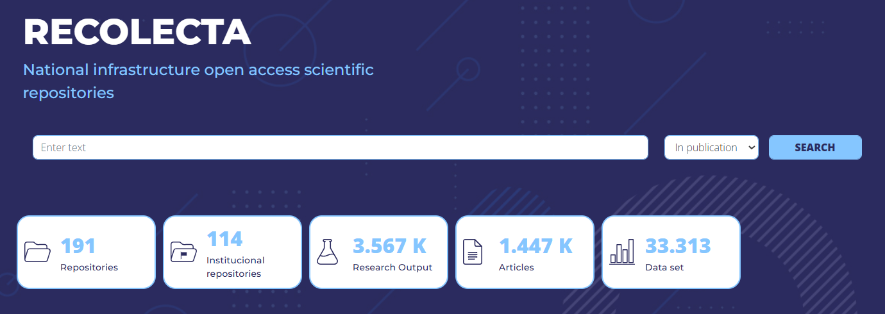
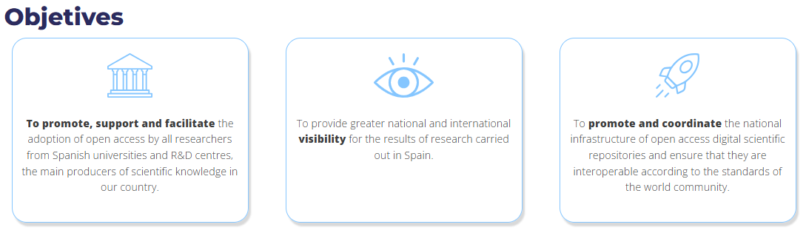

Slide 6
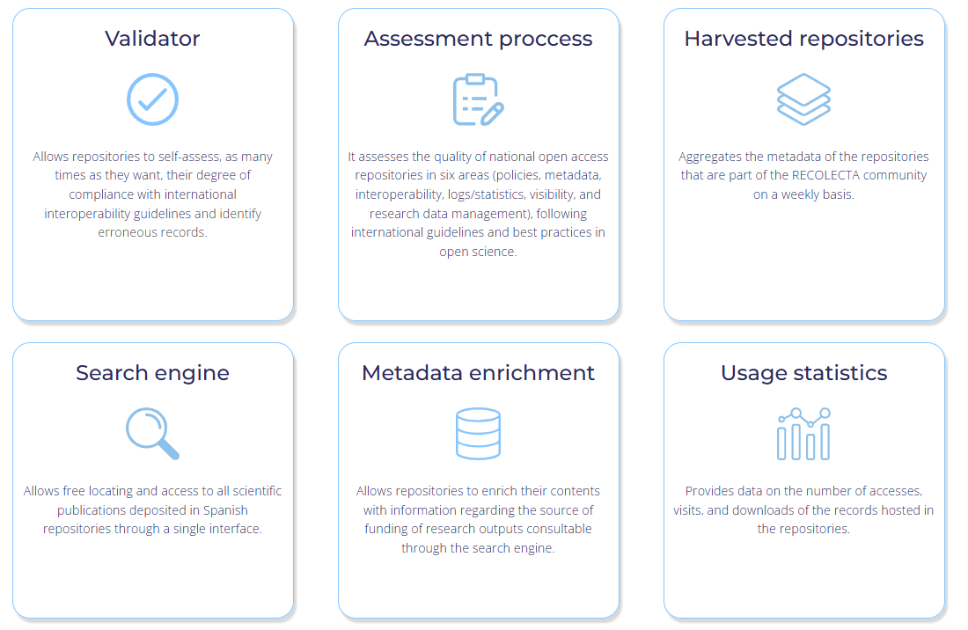

Slide 7
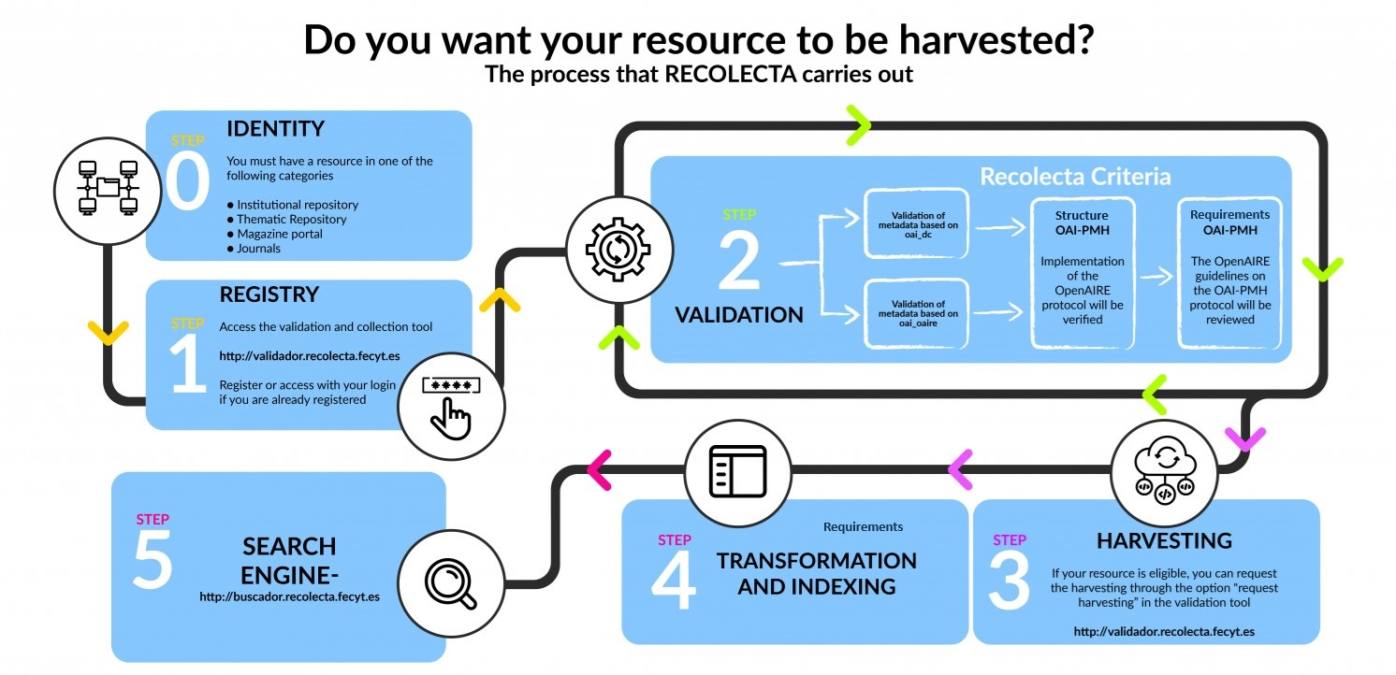

Slide 8
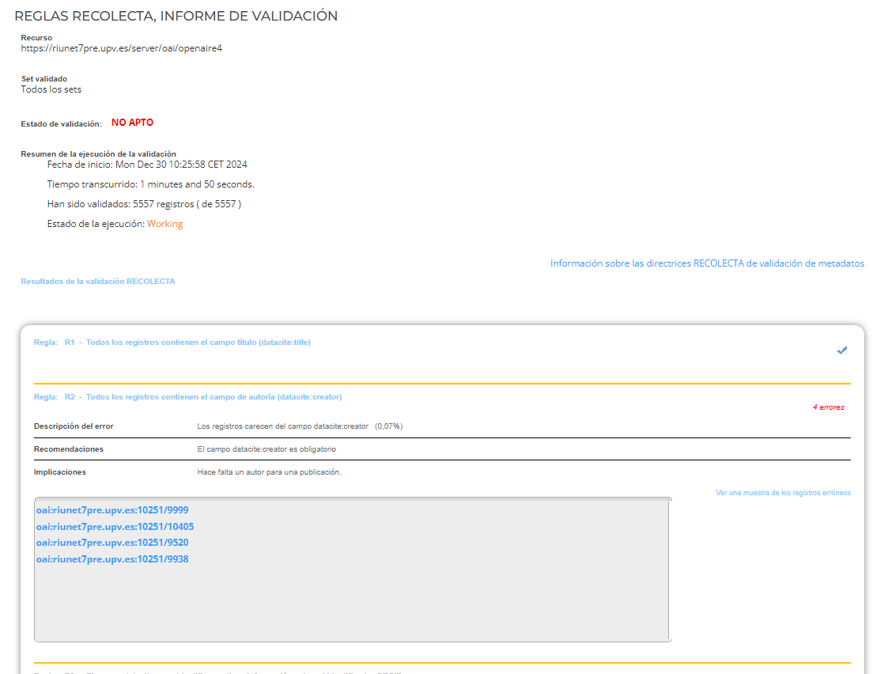
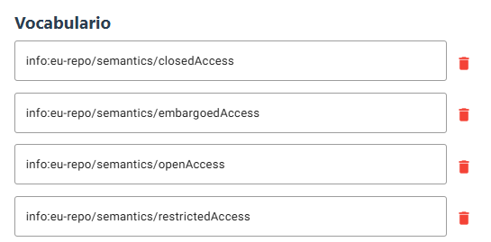
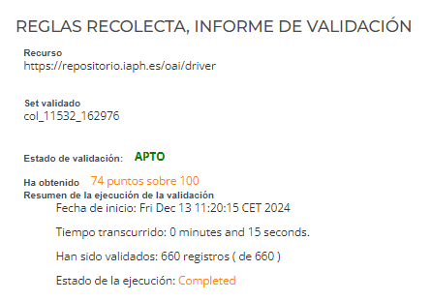


Slide 9
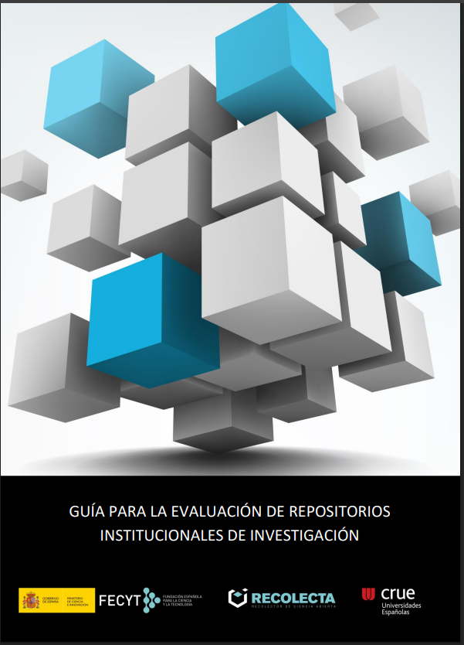
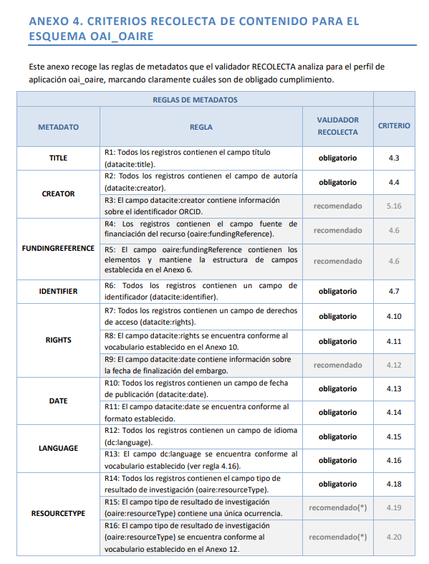
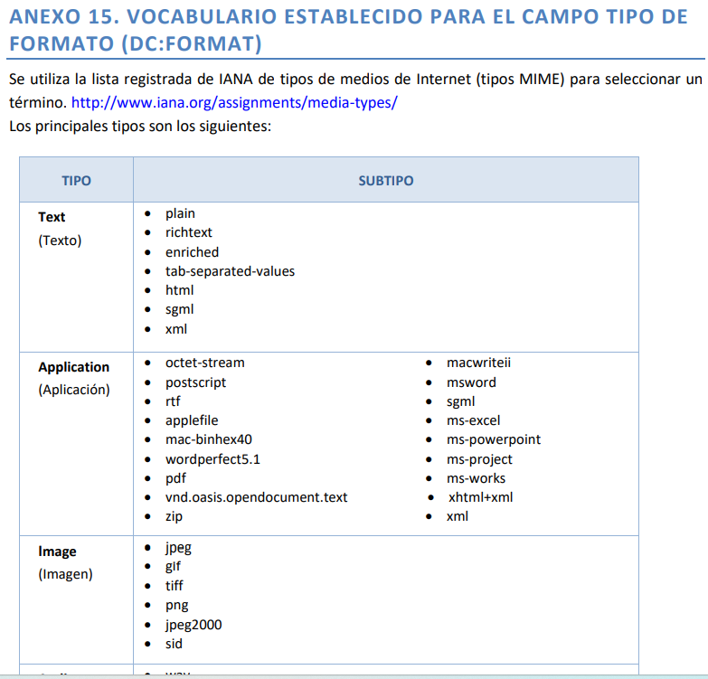
Guide for the Evaluation of Institutional Research Repositories
The Guide for the Evaluation of Institutional Research Repositories provides the entire national community with a set of guidelines, based on existing international criteria, that ensure the interoperability of all open access resources and guarantee high-quality access to their contents. In addition, this guide also includes the mandatory criteria established by RECOLECTA for admission to its platform.
Evaluation criteria
8
Technical elements
/items within criteria
86
Controlled vocabularies
/standardized metadata
3
https://www.recolecta.fecyt.es/sites/default/files/documents/2022GuiaEvaluacionRecolecta.pdf

Slide 10

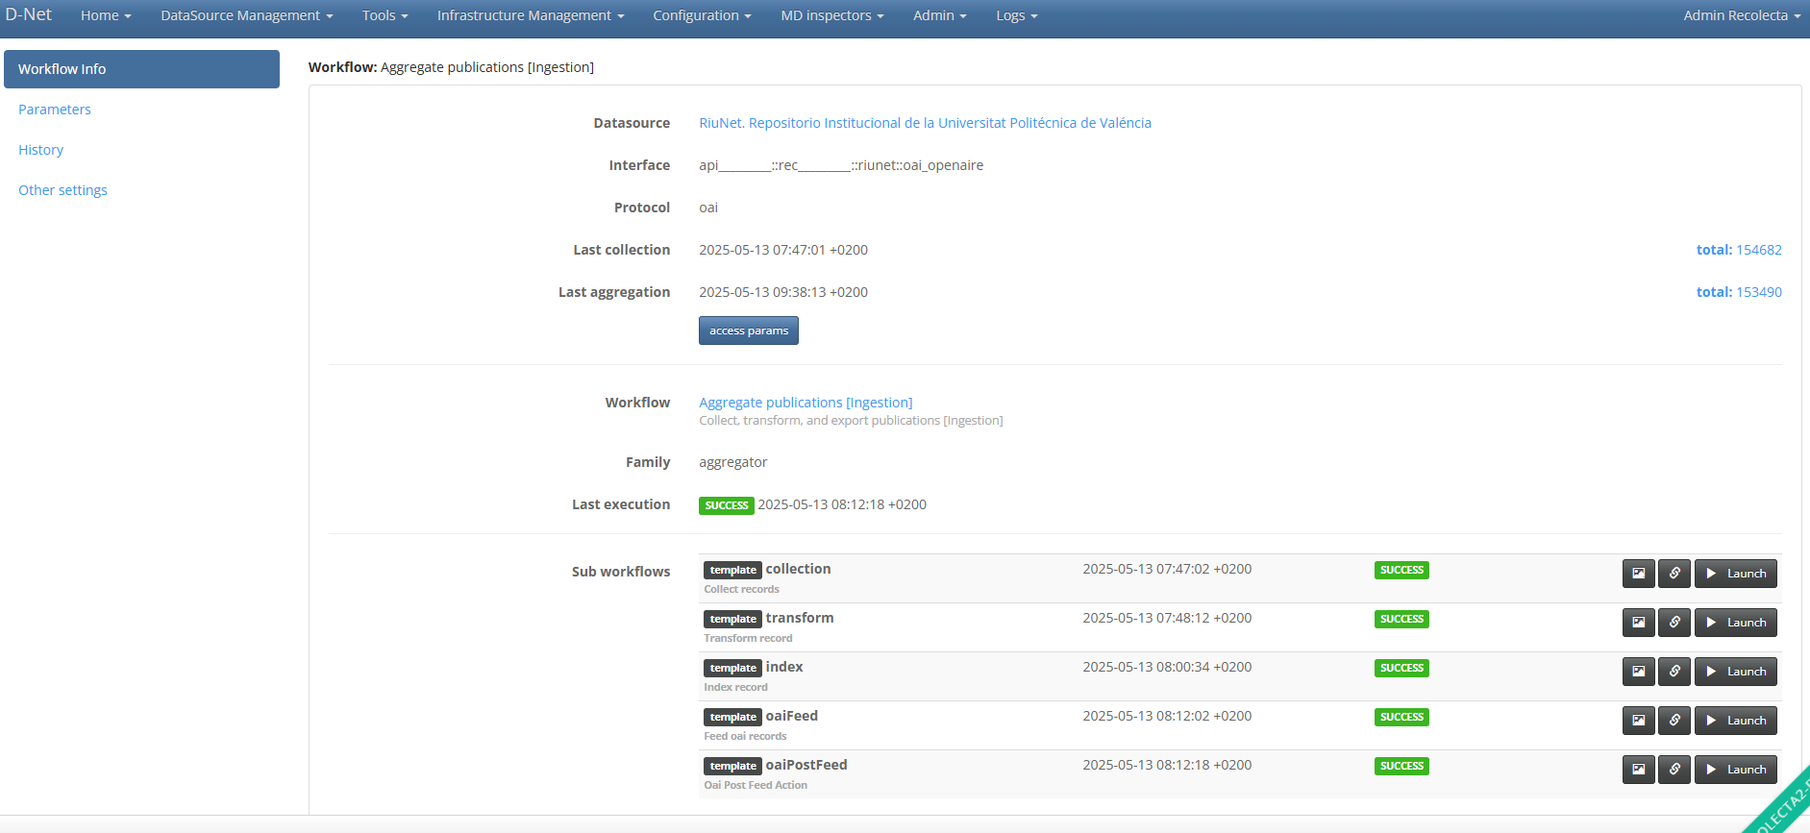


Slide 11
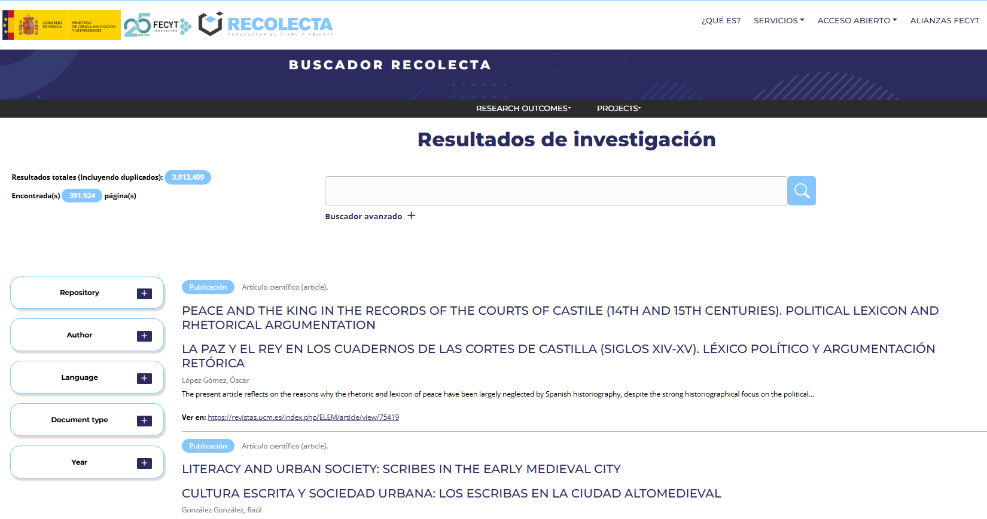
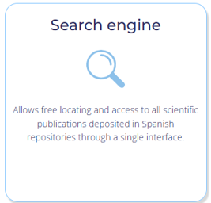

Slide 12
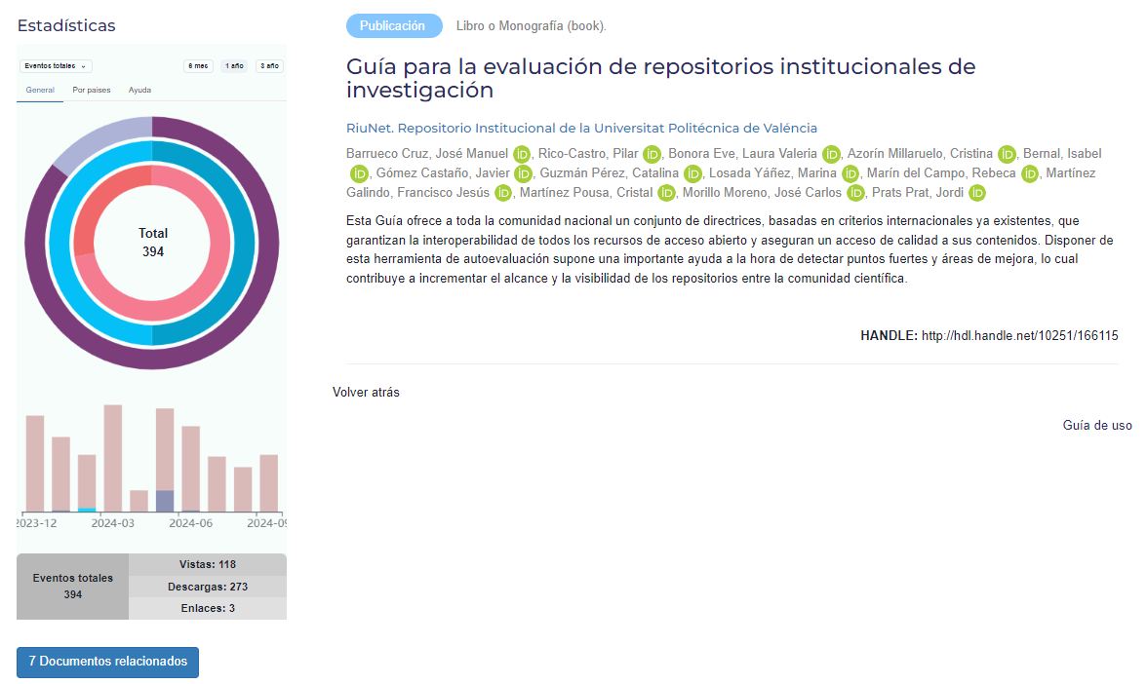

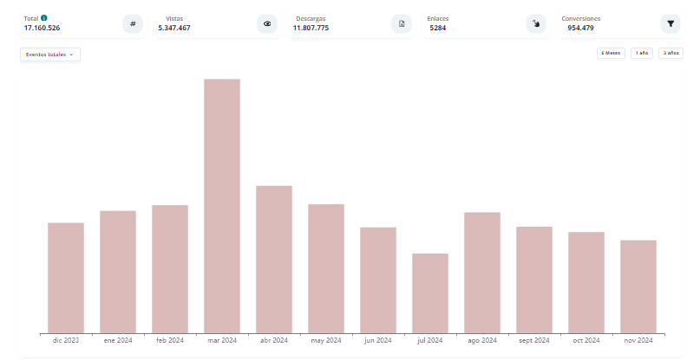
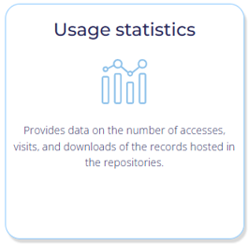

Slide 13
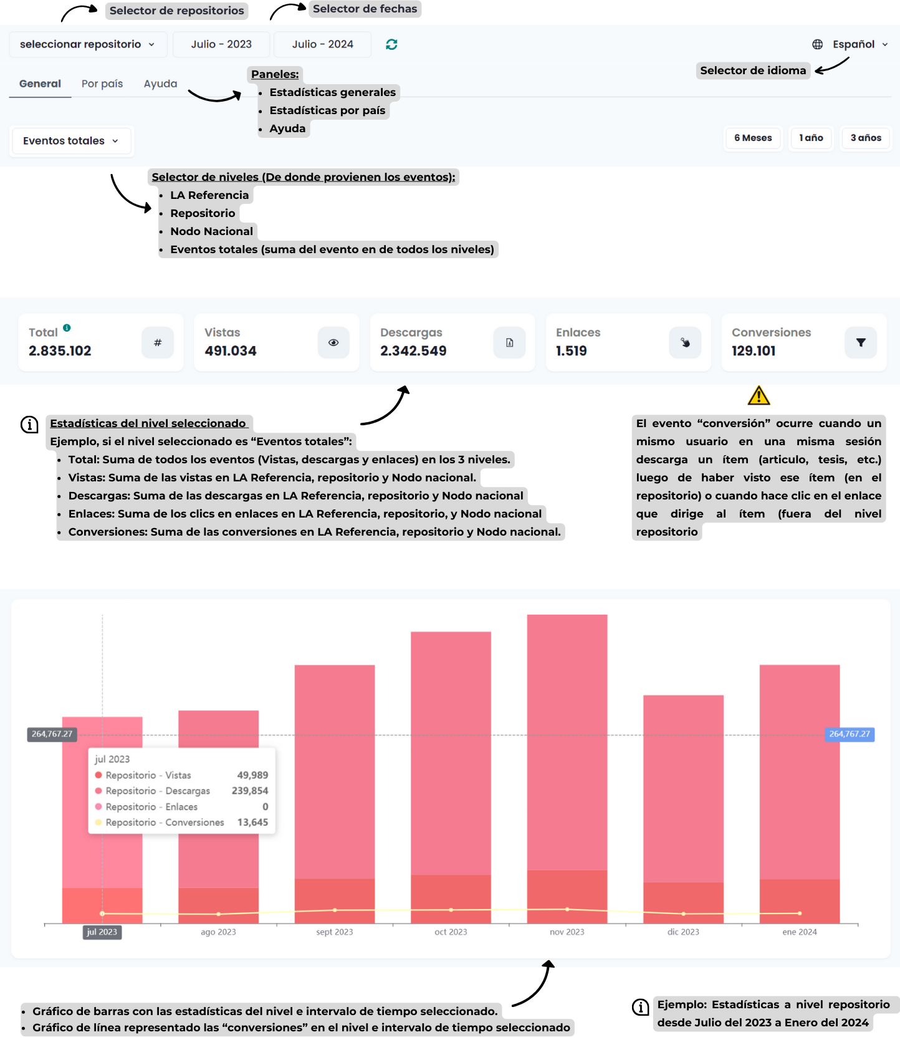

¿Cómo puedo conocer más sobre esta iniciativa?
1.Leer la documentación de instalación.
2.Instalar el Collector y configurar la fecha de inicio de envío.
3.Realizar un primer envío de prueba.
4.Verificar el log.
5.Avisar a su nodo nacional de que se están registrando datos en Matomo.
6.Una vez se confirme que se están enviando datos al Matomo de LA Referencia, configurar la calendarización del Collector tal y como se indica en la documentación técnica. Para la instalación y configuración será necesario conocer el Open DOAR ID y el identificador del repositorio en el Matomo. Esta información es la siguiente:
•Institución: nombre de la institución
•OpenDOAR ID: URL del OpenDOAR asociado al repositorio
•Identificador Matomo: ID Matomo.

Slide 14
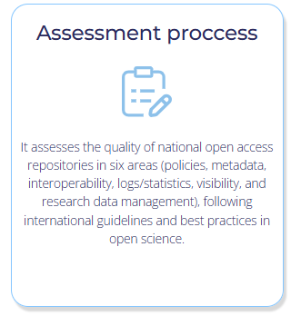
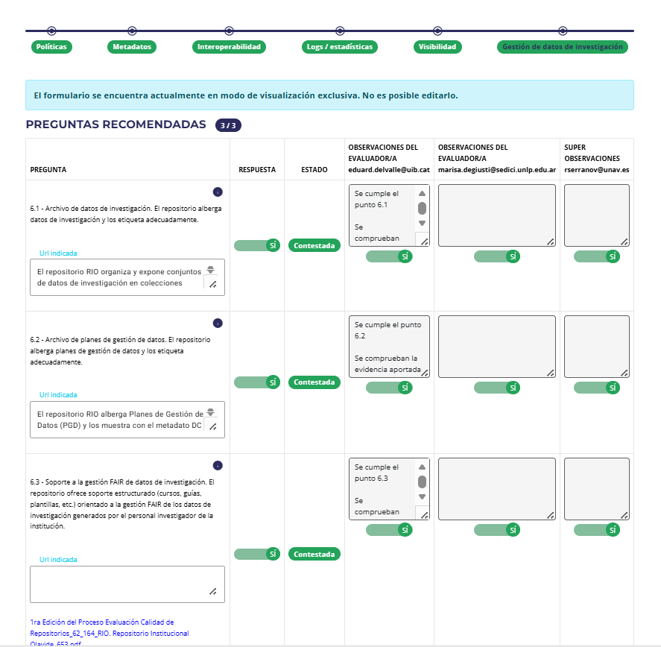
FECYT Seal: quality of national OA repositories
6.1 – Research Data Archive.
The repository hosts research data and labels it appropriately.
6.2 – Data Management Plan Archive.
The repository hosts Data Management Plans and labels them appropriately.
6.3 – Support for FAIR Research Data Management.
The repository provides structured support (courses, guides, templates, etc.) aimed at enabling the FAIR management of research data generated by the institution’s researchers.

Slide 15
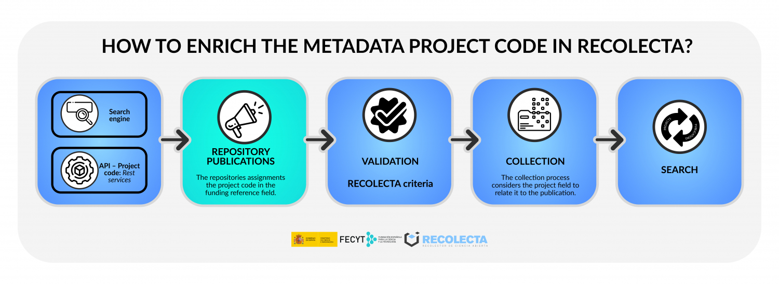


Slide 16
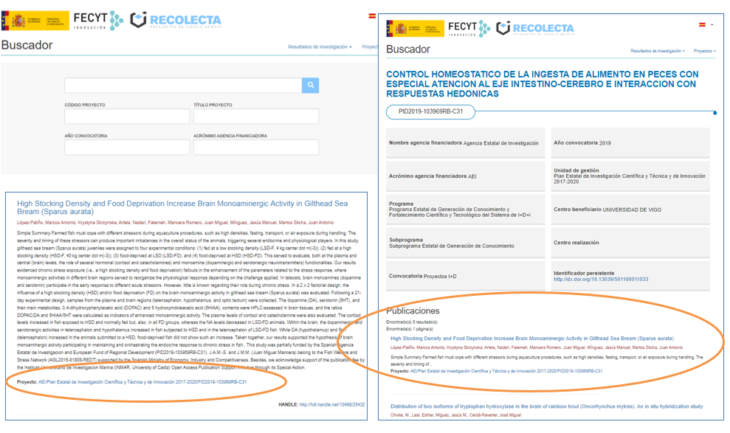

Slide 17
EC Participant Portal - Reporting - Publications (OpenAIRE)
Source: https://zenodo.org/record/7324364#.ZDVoinZBxPY

Slide 18
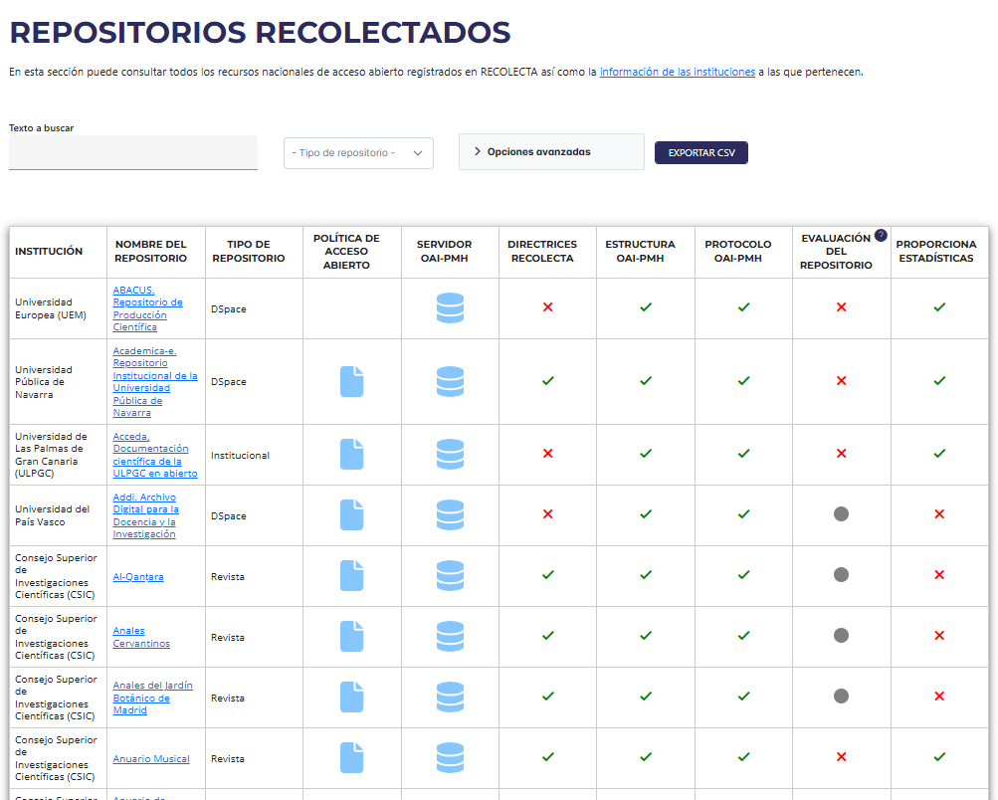

Slide 19
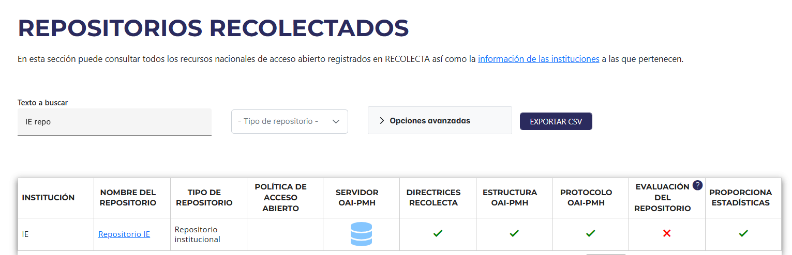





Slide 20
FECYT Alliances & Collaboration

Slide 21
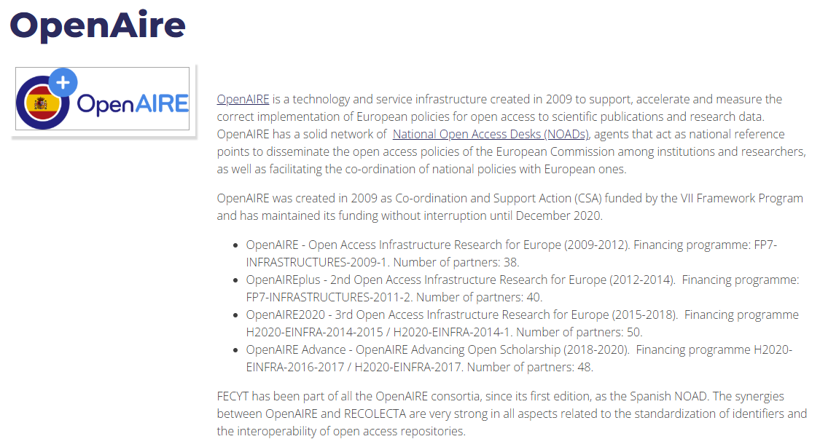

Slide 22
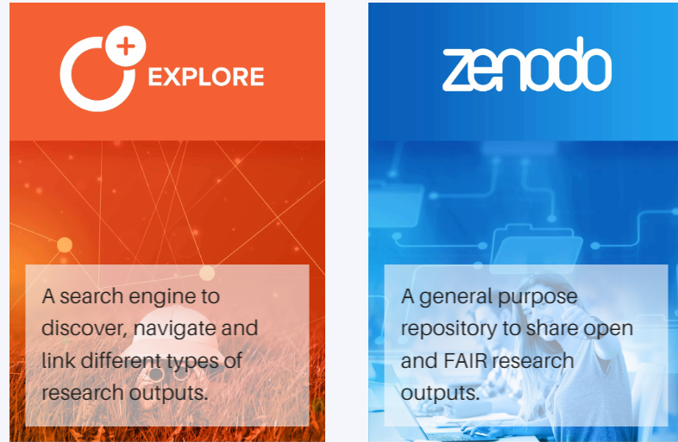
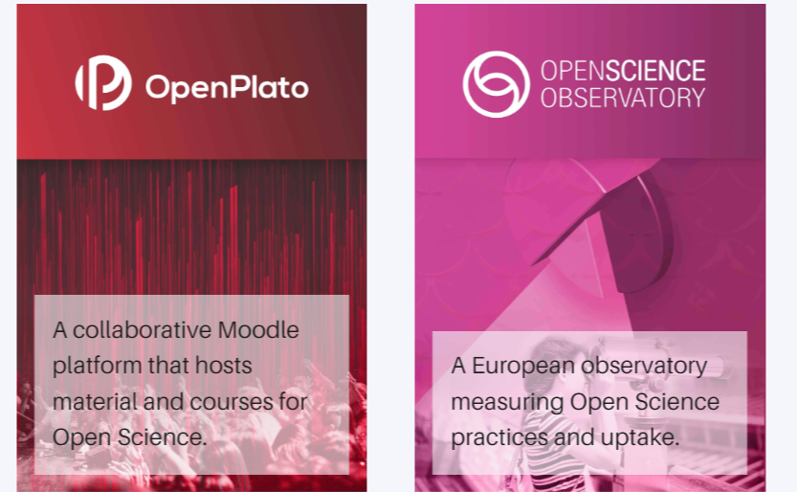
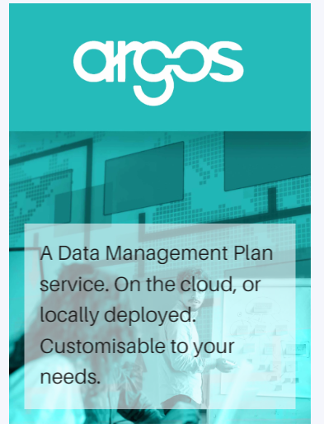
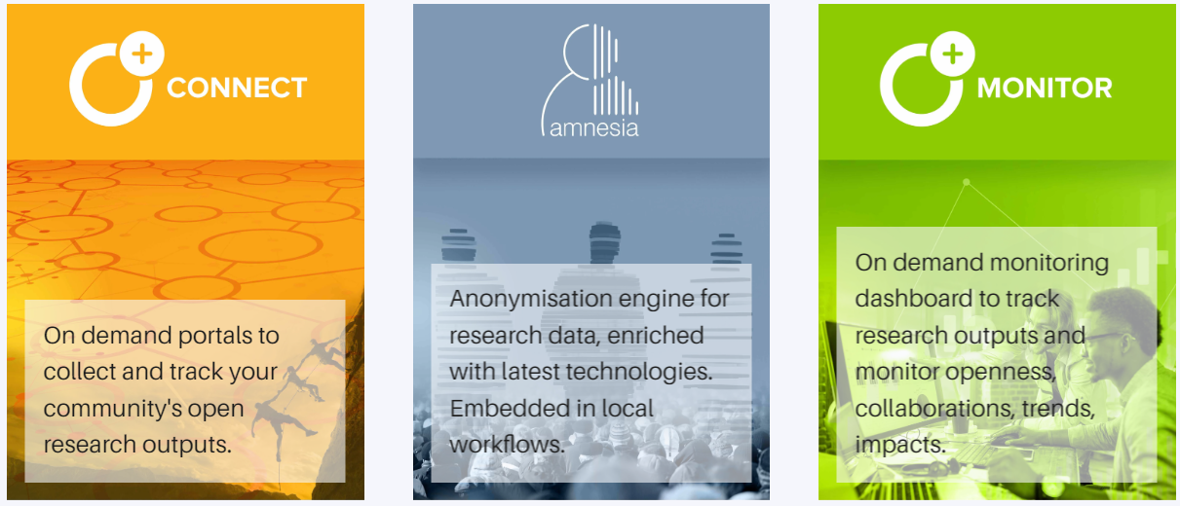

OpenAIRE Services Catalogue
https://catalogue.openaire.eu

Slide 23
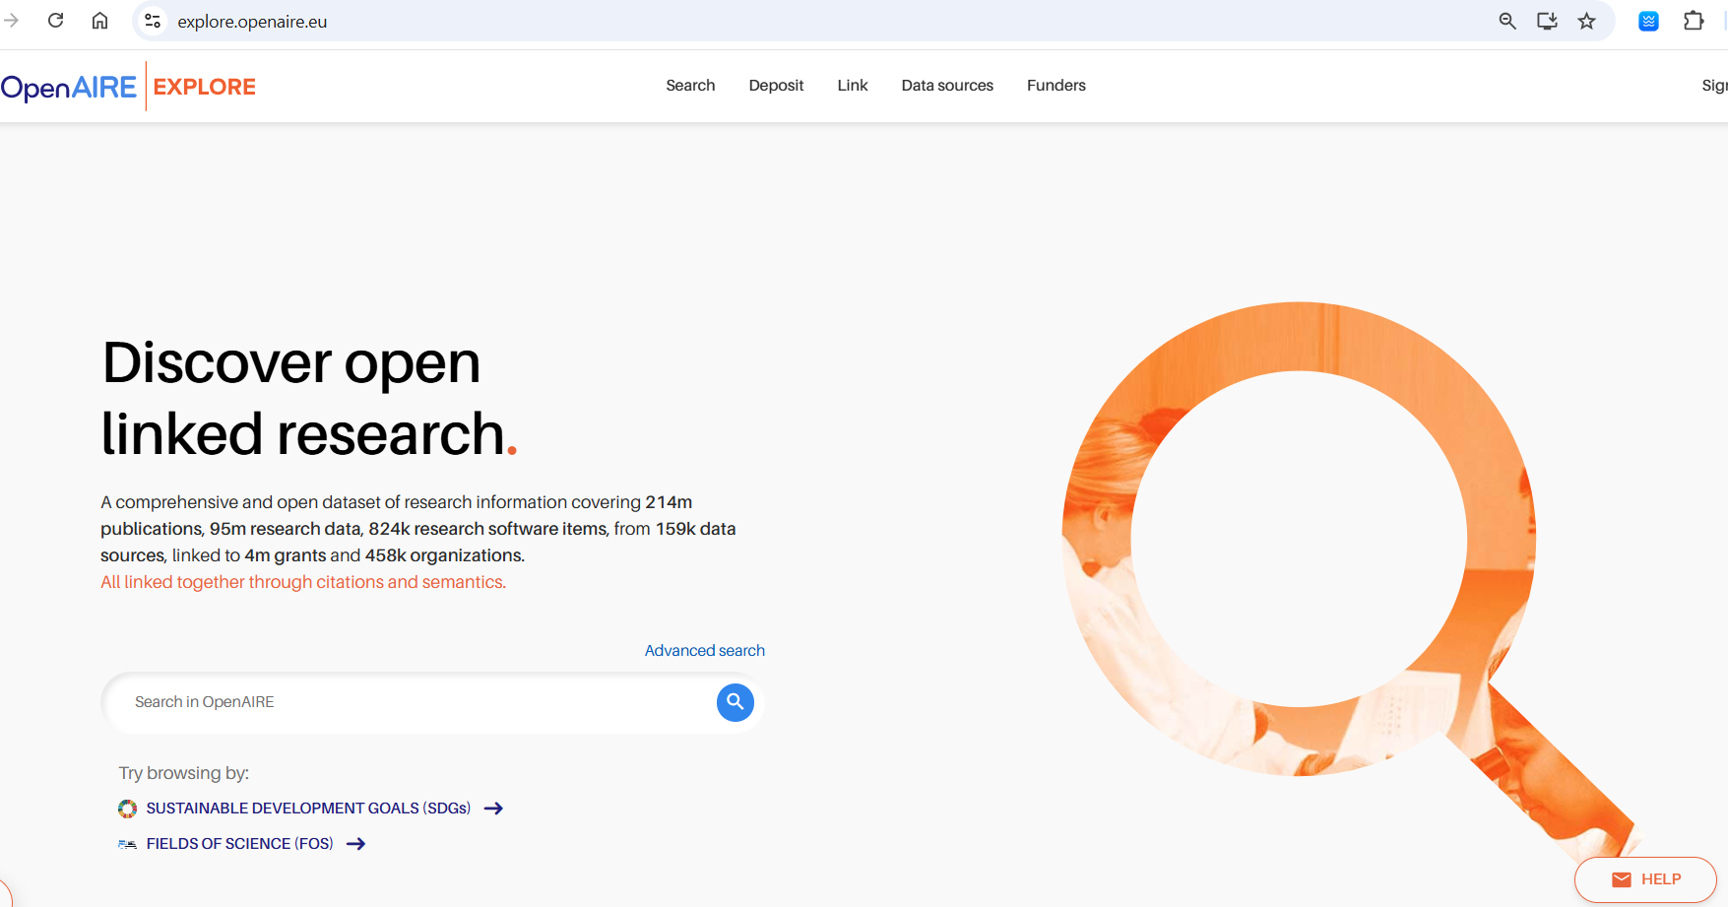
OpenAIRE
https://explore.openaire.eu/

Slide 24
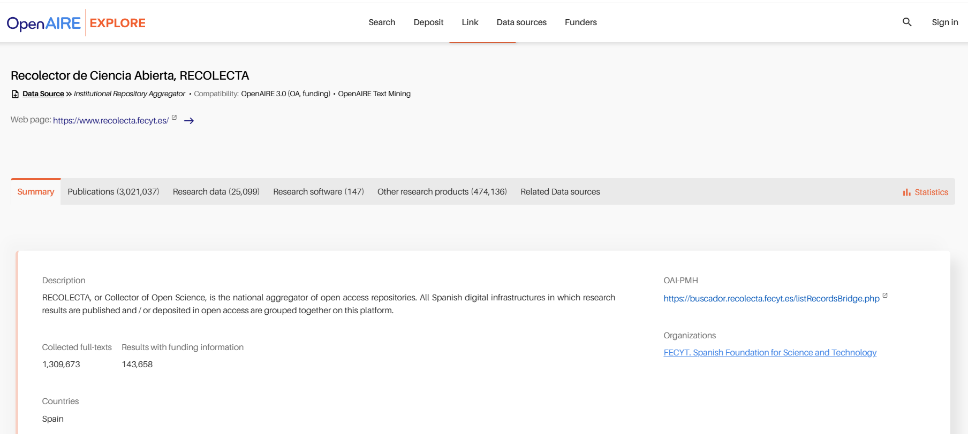

Slide 25
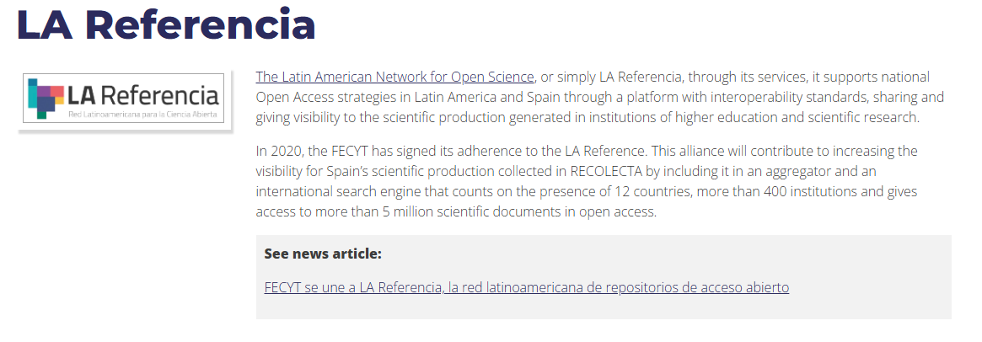

Slide 26
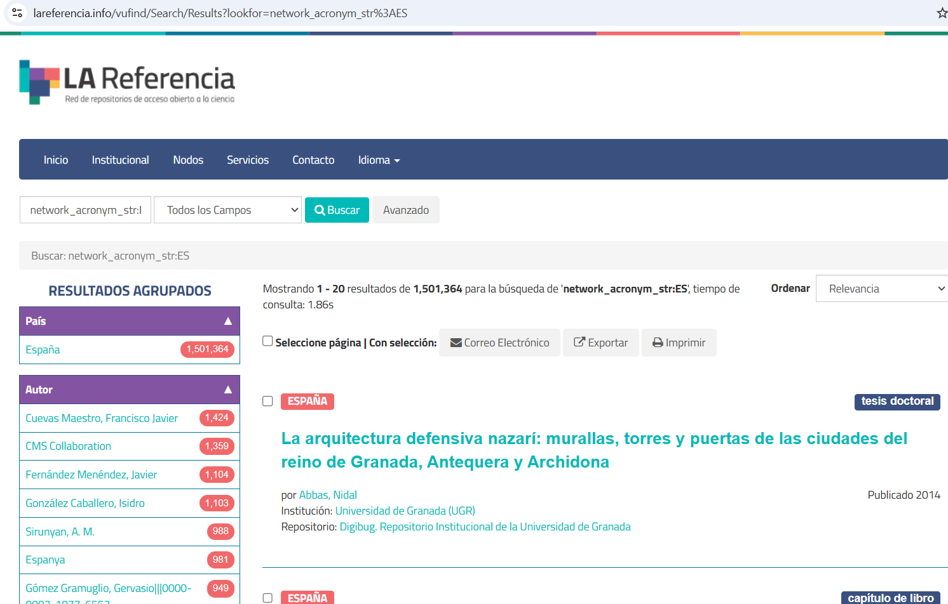

Slide 27
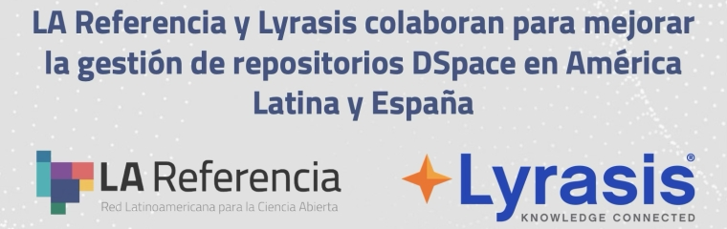
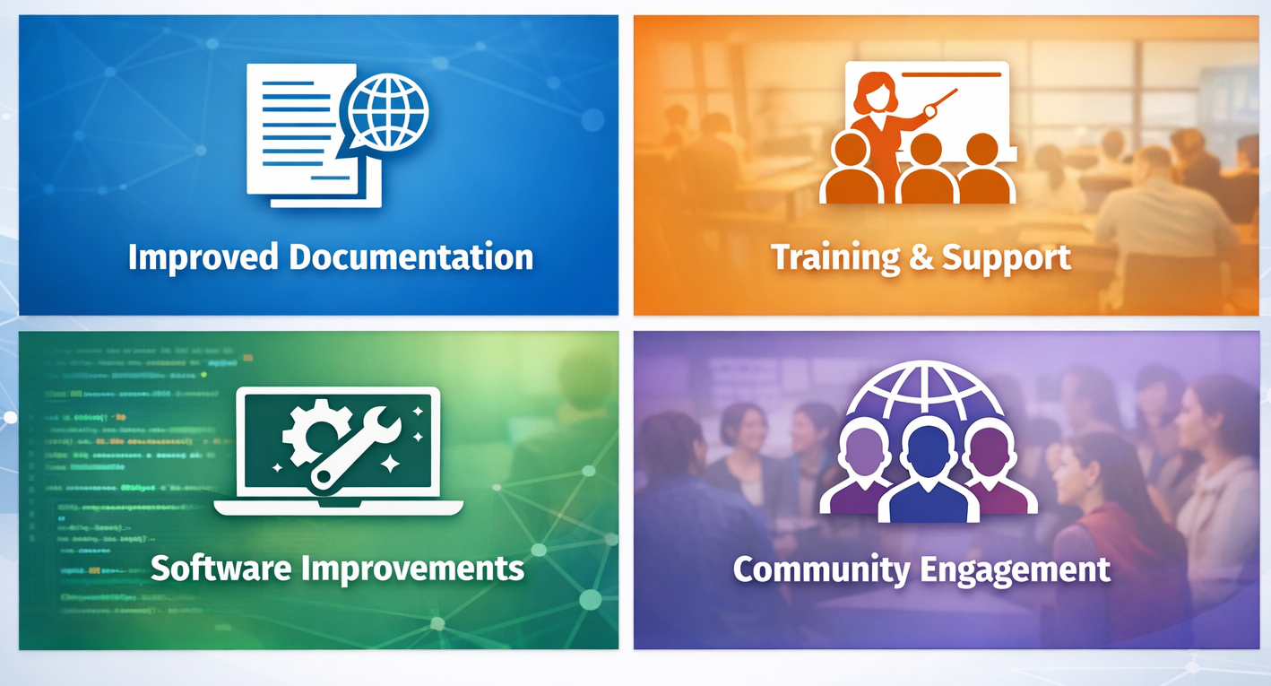
This project aims not only to strengthen the Latin American and Spanish DSpace community, but also to help build a more resilient and connected global DSpace community. It is intended to serve as a model for collaboration in open-source research infrastructures.
The project focuses on four main areas, with improvements designed to benefit both the regional and global DSpace communities:

Slide 28
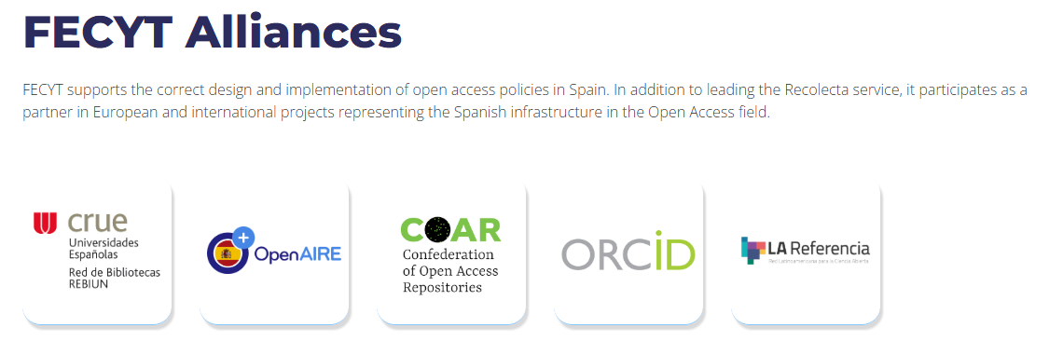
And More…….

Slide 29
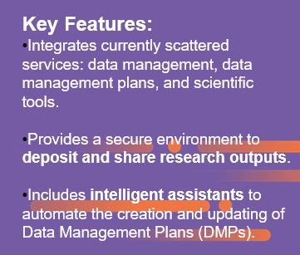

PLATICA. A New Digital Platform to Boost Open Science - DOING
Benefits for Researchers:
Centralized management of data and metadata.
Automated DMP creation, required for project funding.
Ensures interoperability and compliance with FAIR principles.
Benefits for Libraries
Optimizes resources and avoids duplication.
Integrated management ensures quality, traceability, and long-term preservation.
European Alignment
Integrated with the European Open Science Cloud (EOSC).
Aligns Spain with European Open Science standards.

Slide 30
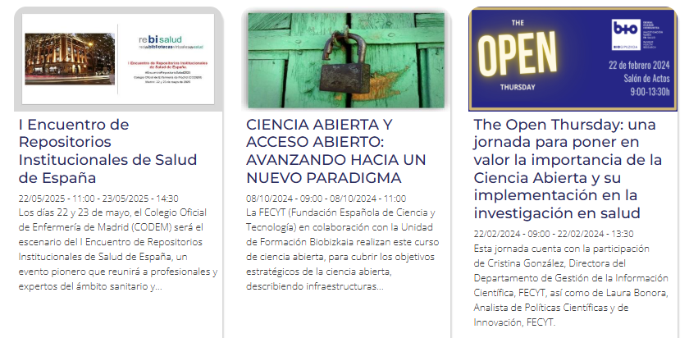
Future prospects
Renew the FECYT Seal on a biennial basis to ensure ongoing compliance with established quality standards.
Strengthen support for the national repository community, providing guidance, resources, and coordination.
Advance discussions with AEI/ISCIII (financial agency) to establish clear and consistent minimum quality criteria for Data Management Plans (DMPs).
Continue the development of the PLATICA project.
Deliver regular training and dissemination activities, with an expected frequency of 1–2 sessions per month

Slide 31
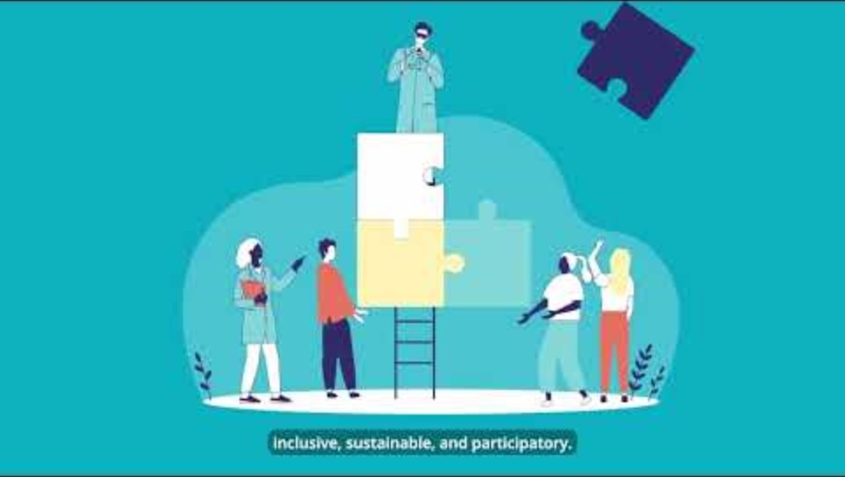

Slide 32





Thanks
laura.bonora@fecyt.es
Síguenos:

