Slide 1





IE Repository: a Key Infrastructure for Research Support.
Patricia Riba
IE University Library
patricia.riba@ie.edu

Slide 2
Visibility is not enough:
Many access options to the information, but fragmented dissemination
The problems we are responding to:
Fragmented content
Short-term platforms
Academic outputs dispersed across multiple platforms, systems and individual spaces
Dissemination channels focused on visibility rather than long-term preservation
Limited preservation
Lack of institutional control
Challenges in ensuring sustained access and preservation over time
Limited institutional oversight over how and where academic knowledge is managed

Slide 3
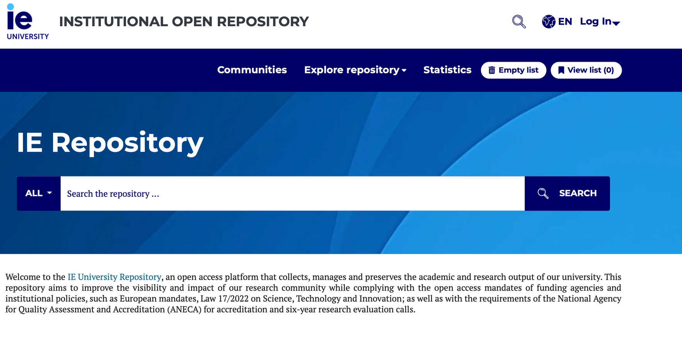
IEU Repository
A response to
fragmented
dissemination
Research,
teaching and
institutional
knowledge
Texto
Long-term access
and preservation
https://repositorio.ie.edu/home

Slide 4

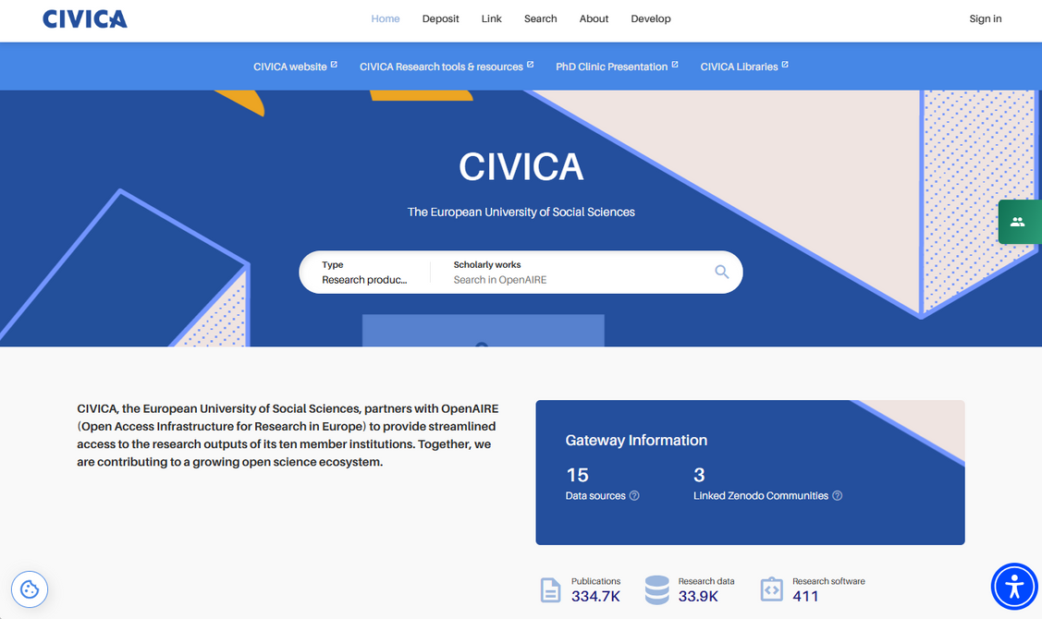



Visibility, indexing and integration
Integrated into major national and international aggregation services:
https://civica.openaire.eu/

Slide 5
Aligned with policies and mandates
Allows compliance and responsible research practices
Funder requirements
Open access policies
Supporting European and
National policies
Facilitating compliance
with funder mandates
FAIR principles
Interoperability
Enabling interoperability
across systems
Applying FAIR principles
in practice

Slide 6
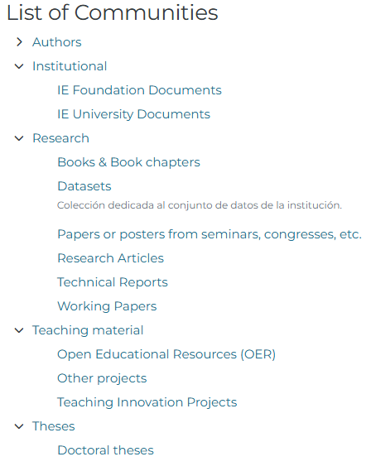
Structure and long-term sustainability
Structured collections
The repository is organised into structured collections that reflect IE’s academic activity across research, teaching and institutional outputs
Persistent identification
PID’s are assigned to all items, using Handles as standard and DOIs where appropriate, to ensure stable and reliable access over time.
Standards-based metadata
The repository applies Dublin Core metadata in accordance with national and international guidelines, including those developed by REBIUN and OpenAIRE.
Long-term digital preservation
Long-term preservation is supported through the use of sustainable file formats, combined with ongoing metadata curation and institutional preservation practices.

Slide 7
Why IE Repository matters
The IE Repository is a core institutional infrastructure for managing, sharing and preserving academic knowledge.
It supports visibility, policy compliance and long-term sustainability within the European open science framework.

Slide 8
THANK
YOU
https://library.ie.edu/research/
openaccess@ie.edu

